Slide 1
Democracy and Rule of Law in international relations
Pisa Winter School
Raquel Cavalcanti Ramos Machado Malenchini
Professor of Theory of Democracy at the Federal University of Ceará Brazil

Slide 2
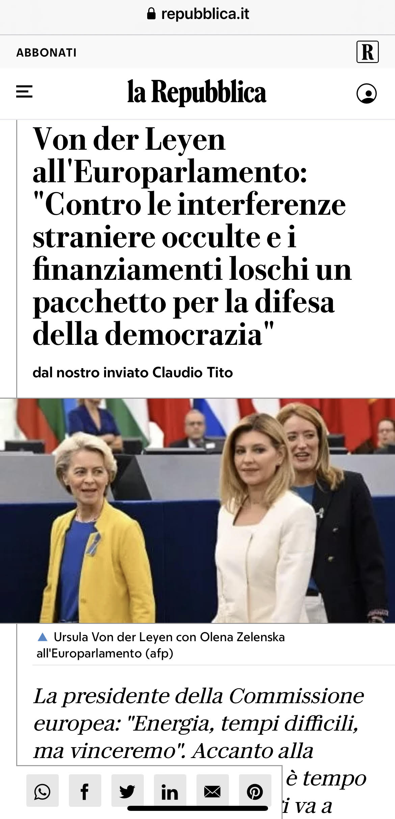
Democratic and anti-democratic waves and the importance of defending democratic countries from a democratic counter-wave on the international level
This is part of our work of strengthening our democracies. But we should not lose sight of the way foreign autocrats are targeting our own countries. Foreign entities are funding institutes that undermine our values. Their disinformation is spreading from the internet to the halls of our universities. Earlier this year, a university in Amsterdam shut down an allegedly independent research centre, which was actually funded by Chinese entities. This centre was publishing so-called research on human rights, dismissing the evidence of forced labour camps for Uyghurs as “rumours”. These lies are toxic for our democracies. Think about this: We introduced legislation to screen foreign direct investment in our companies for security concerns. If we do that for our economy, shouldn't we do the same for our values?We need to better shield ourselves from malign interference. This is why we will present a Defence of Democracy package. It will bring covert foreign influence and shady funding to light. We will not allow any autocracy's Trojan horses to attack our democracies from within. For more than 70 years, our continent has marched towards democracy. But the gains of our long journey are not assured. Many of us have taken democracy for granted for too long. Especially those, like me, who have never experienced what it means to live under the fist of an authoritarian regime. Today we all see that we must fight for our democracies. Every single day. We must protect them both from the external threats they face, and from the vices that corrode them from within. It is my Commission's duty and most noble role to protect the rule of law. So let me assure you: we will keep insisting on judicial independence. (…) Our founders only meant to lay the first stone of this democracy. They always thought that future generations would complete their work. “Democracy has not gone out of fashion, but it must update itself in order to keep improving people's lives.” These are the words of David Sassoli – a great European, who we all pay tribute to today. David Sassoli thought that Europe should always look for new horizons. And through the adversities of these times, we have started to see what our new horizon might be. A braver Union. Closer to its people in times of need. Bolder in responding to historic challenges and daily concerns of Europeans. And to walk at their side when they deal with the big trials of life. https://ec.europa.eu/commission/presscorner/detail/ov/speech_22_5493

Slide 3
Democratic and anti-democratic waves and the importance of defending democratic countries from a democratic counter-wave on the international level

Slide 4
Structure of today's lesson/class/speech
Complexity of conceptualizing the term democracy and difficulty in assuming democracy as a principle of International Law (self-determination of peoples)
The democratic waves and the international commitment to democracy
Democratic/anti-democratic contagion and the importance of defending it on the international stage
International or community legal action in defense of democracy - norms and actions of legal entities governed by international or community law in defense of democracy

Slide 5
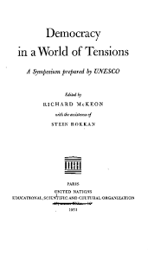
The complexity of conceptualizing democracy and the difficulty in assuming democracy as a criterion in internacional relations
- difficulty in establishing clear parameters to impose a global democratic regime model. Furthermore, democracy is a complex and costly regime, which often requires a slow transition. (Democracy in a world of tensions; a Symposium prepared by UNESCO, 1951)
- self-determination of peoples and different paths to realize fundamental rights other than political rights, such as the right to security and the existential minimum

Slide 6
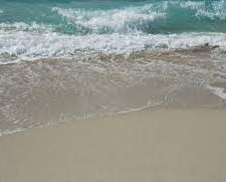
The democratic waves and the international commitment to democracy
First wave - 1828/1926 (French and American revolutions)
1st counter/reverse wave – 1922 / 1942 (European totalitarian governments)
2nd wave -1943/1962 (end of World War II - Universal Declaration of Human Rights, article 21)
2nd counter/reverse wave – 1958/1975 (transition regimes acquire an authoritarian tone)
3rd wave – 1974... (Difficulties in legitimizing authoritarianism in an international context of expansion of democratic democratic values; world economic growth; Second Vatican Council (1963/65 - declaration Dignitatis humanæ on the civil right to religious freedom); birth of European Union, enlargement of the members of the European Community, Copenhagen criteria (1993); "avalanche" effect, development of dimensions of democracy, such as environmental democracy, with the Rio Declaration and the Aarhus Convention)
4th wave – South Africa transition to democracy - in the 90s (Ian Shapiro)
3rd and 4th counter/reverse wave - reactions to the Arab Spring, post-truth, disinformation, manipulation of news, interference of non-democratic or few democratic third countries in the affairs of democratic countries (2015 - )
5th wave (?) – defense of democracy by international and domestic institutions, and as a criterion for international relations, based on rules to protect democracy

Slide 7
DIMENSIONS OF DEMOCRACY: THE INDIVIDUAL AND SOCIETY IMMERSED IN RIGHTS
Despite the challenges and crises of democracy, the 20th century saw what can be called the maximization of democracy, with the expansion of fundamental rights and democracy as a political regime. At the beginning of the 21st century, democracy begins to face important challenges arising from a globalized scenario that requires international action to protect it

Slide 8
First democratic wave - beginning of the defense of freedom and equality as a human right
Declaration of the Rights of Man and of the Citizen - 1789
Art. 1 – Men are born and remain free and equal in rights. Social distinctions may be founded only upon the general good
Art. 6 – Law is the expression of the general will. Every citizen has a right to participate personally, or through his representative, in its foundation. It must be the same for all, whether it protects or punishes. All citizens, being equal in the eyes of the law, are equally eligible to all dignities and to all public positions and occupations, according to their abilities, and without distinction except that of their virtues and talents.

Slide 9
First democratic wave - beginning of the defense of freedom and equality as a human right
The Virginia Declaration of Rights – 1776
Section 2
That all power is vested in, and consequently derived from, the people; that magistrates are their trustees and servants and at all times amenable to them.

Slide 10
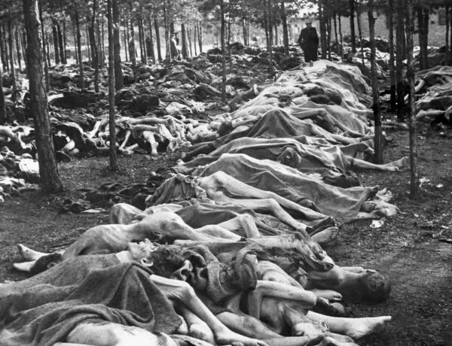
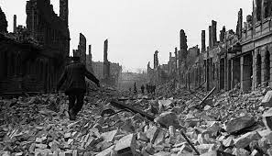
The importance of democracy for the European Union and for the world
Notes:
Insira um mapa do seu país.

Slide 11
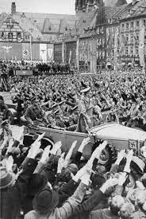
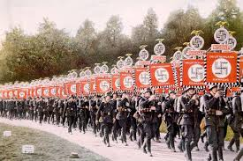
The importance of democracy for the European Union and for the world
Notes:
Insira um mapa do seu país.

Slide 12
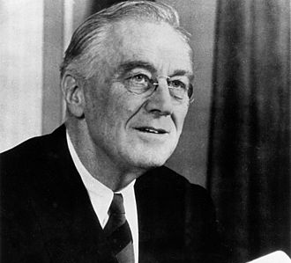
The importance of democracy for the European Union and for the world
“DEMOCRATIC ARSENAL” expression used by Jean Monnet regarding American aid during the Second World War and also by Roosevelt in his speech about the beginning of American aid to Great Britain's exercise.(Jean Monnet, Memorie. London: Collins, 1978, p. 160)
In this photo, the American president Franklin D. Roosevelt, during the Second World War

Slide 13
Second Democratic Wave - beginning of the defense of democracy as a human right at the international level?
Universal Declaration of Human Rights (1948)
Article 21
Everyone has the right to take part in the government of his country, directly or through freely chosen representatives.
Everyone has the right of equal access to public service in his country.
The will of the people shall be the basis of the authority of government; this will shall be expressed in periodic and genuine elections which shall be by universal and equal suffrage and shall be held by secret vote or by equivalent free voting procedures.

Slide 14
Third and Fourth Democratic Waves - expressive expansion of democracy and recognition of democracy as a criterion for establishing international relations (European Union)
Treaty on European Union (Maastricht, 7 February 1992) -
CONFIRMING their attachment to the principles of liberty, democracy and respect for human rights and fundamental freedoms and of the rule of law
(…)
DESIRING to enhance further the democratic and efficient functioning of the institutions so as to enable them better to carry out, within a single institutional framework, the tasks entrusted to them
Article J.1
1. The Union and its Member States shall define and implement a common foreign and security policy, governed by the provisions of this Title and covering all areas of foreign and security policy.
2. The objectives of the common foreign and security policy shall be:
- (…) - to develop and consolidate democracy and the rule of law, and respect for human rights and fundamental freedoms

Slide 15
Third and Fourth Democratic Waves - expressive expansion of democracy and recognition of democracy as a criterion for establishing international relations (European Union)
Treaty of Lisbon - AMENDING THE TREATY ON EUROPEAN UNION AND THE TREATY ESTABLISHING THE EUROPEAN COMMUNITY
Signed: December 13, 2007 Effective date: December 1, 2009
In order to strengthen the efficiency and democratic legitimacy of the Union as well as improve the coherence of its action

Slide 16
Third and Fourth Democratic Waves - expressive expansion of democracy and recognition of democracy as a criterion for establishing international relations (European Union)
The Treaty of Lisbon - A RTICLE 1a - The Union is founded on the values of respect for human dignity, freedom, democracy, equality, the rule of law and respect for human rights, including the rights of persons belonging to minorities. These values are common to the Member States in a society in which pluralism, non-discrimination, tolerance, justice, solidarity and equality between women and men prevail.
Articolo 21 - 1. The Union’s action on the inter-national scene shall be guided by the principles which have inspired its own creation, development and enlargement, and which it seeks to advance in the wider world: democracy, the rule of law, the universality and indivisibility of human rights and fundamental freedoms, respect for human dignity, the principles of equality and solidarity, and respect for the principles of the United Nations Charter and international law.

Slide 17
Third and Fourth Democratic Waves - expressive expansion of democracy and recognition of democracy as a criterion for establishing international relations (European Union)
Treaty of Lisbon
Article 10.o
1. The functioning of the Union is based on representative democracy.
2. Citizens are directly represented, at Union level, in the European Parliament. Member States are represented in the European Council by their Head of State or Government and in the Council by their respective governments, themselves democratically accountable, to their national parliaments or to their citizens.
3. All citizens have the right to participate in the democratic life of the Union. Decisions are made as openly and as closely as possible to citizens.
4. Political parties at European level contribute to the creation of European political awareness and the expression of the will of the citizens of the Union.

Slide 18
Third and Fourth Democratic Waves - expressive expansion of democracy and recognition of democracy as a criterion for establishing international relations (European Union)
Treaty of Lisbon
Art. 11 - relationship with the Aarhus Convention (1998, prior to the Treaty of Lisbon - and which recognizes the public's right to access information and participate in decisions on environmental matters, as well as the right of recourse if these rights are not respected. )
1. The institutions give citizens and representative associations, through appropriate channels, the opportunity to make known and publicly exchange their opinions in all sectors of the Union's action.
2. The institutions maintain an open, transparent and regular dialogue with representative associations and civil society.
3. In order to ensure the coherence and transparency of the Union's actions, the European Commission carries out extensive consultations with interested parties.
4. Citizens of the Union, numbering at least one million, who are nationals of a significant number of Member States, may take the initiative to invite the European Commission, within the scope of its powers, to present a proposal appropriate on matters in respect of which those citizens consider a Union legal act to be necessary for the implementation of the Treaties.

Slide 19
Third and Fourth Democratic Waves - expressive expansion of democracy and recognition of democracy as a criterion for establishing international relations (European Union)
Given the European Union's commitment and concern for democracy, it must be experienced:
Within each member state
In relation to third countries ( https://www.europarl.europa.eu/factsheets/it/sheet/166/promozione-della-democracy-e-monitoraggio-elettorale) + Program to support global democracy - https:// www.europarl.europa.eu/globaldemocracysupport/en/home/home (since 2012)
In the European institutions, especially in the European Parliament

Slide 20
INTER-AMERICAN DEMOCRATIC CHARTER - Organization of American States - 2001
CONSIDERING that the Charter of the Organization of American States recognizes that representative democracy is indispensable for the stability, peace, and development of the region, and that one of the purposes of the OAS is to promote and consolidate representative democracy, with due respect for the principle of nonintervention;
BEARING IN MIND the progressive development of international law and the advisability of clarifying the provisions set forth in the OAS Charter and related basic instruments on the preservation and defense of democratic institutions, according to established practice,

Slide 21
INTER-AMERICAN DEMOCRATIC CHARTER - Organization of American States - 2001
INTER-AMERICAN DEMOCRATIC CHARTER
I
Democracy and the Inter-American System
Article 1
The peoples of the Americas have a right to democracy and their governments have an obligation to promote and defend it. Democracy is essential for the social, political, and economic development of the peoples of the Americas.
Article 2
The effective exercise of representative democracy is the basis for the rule of law and of the constitutional regimes of the member states of the Organization of American States. Representative democracy is strengthened and deepened by permanent, ethical, and responsible participation of the citizenry within a legal framework conforming to the respective constitutional order.

Slide 22
AFRICAN CHARTER ON DEMOCRACY, ELECTIONS AND GOVERNANCE - 2007
Art. 2
The objectives of this Charter are to:
1. Promote adherence, by each State Party, to the universal values and principles of democracy and respect for human rights;
(…)
3. Promote the holding of regular free and fair elections to institutionalize legitimate authority of representative government as well as democratic change of governments;

Slide 23
5th wave – defense of democracy by international and domestic institutions, based on rules to protect democracy
Vienna Declaration and Programme of Action - 1993
66. The World Conference on Human Rights recommends that priority be given to national and international action to promote democracy, development and human rights.
(…)
74. The World Conference on Human Rights appeals to Governments, competent agencies and institutions to increase considerably the resources devoted to building well-functioning legal systems able to protect human rights, and to national institutions working in this area. Actors in the field of development cooperation should bear in mind the mutually reinforcing interrelationship between development, democracy and human rights.
https://www.ohchr.org/en/instruments-mechanisms/instruments/vienna-declaration-and-programme-action

Slide 24
5th wave – defense of democracy by international and domestic institutions, based on rules to protect democracy
UNITED NATIONS MILLENNIUM DECLARATION 2000 - General Assembly resolution 55/2
V. Human rights, democracy and good governance
24. We will spare no effort to promote democracy and strengthen the rule of law, as well as respect for all internationally recognized human rights and fundamental freedoms, including the right to development.
https://www.ohchr.org/en/instruments-mechanisms/instruments/united-nations-millennium-declaration

Slide 25
5th wave – defense of democracy by international and domestic institutions, based on rules to protect democracy
United Nations Democracy Fund: Projects that promote democracy - The United Nations Democracy Fund (UNDEF) invites civil society organizations to submit project proposals for co-funding projects to promote and support democracy. The United Nations Democracy Fund was established by the United Nations Secretary-General in 2005 to support democratization efforts around the world. UNDEF supports projects that strengthen the voice of civil society, promote human rights, and encourage the participation of all groups in democratic processes (support initiatives in the areas of: Support for Electoral Processes, Women's Empowerment, Media and Freedom of Information, Rule of Law and Human Rights, Strengthening Civil Society Interaction with Government, Youth Engagement)
15 SEPTEMBER - INTERNATIONAL DAY OF DEMOCRACY - The International Day of Democracy is celebrated on 15 September each year and was proclaimed on 8 November 2007 by the United Nations General Assembly. The Day represents an opportunity to reflect on the state of democracy in the world.
Resolution approved by the UN Human Rights Council 28/14 de 20015 - establishing a forum on human rights, democracy and the rule of law
UN 2030 Agenda for Sustainable Development - Target 16.7
Aarhus Convention and Escazú Agreement - recognition of environmental democracy by two legal norms - Convinced that the application of this Convention will contribute to the strengthening of democracy in the United Nations Economic Commission for Europe (UN/ECE) region
Action Plan for European Democracy
European Defence of Democracy package (2024 - )

Slide 26
5th wave – defense of democracy by international and domestic institutions, based on rules to protect democracy
Resolution approved by the UN Human Rights Council 28/14 of 2015 -
In resolution 28/14, adopted on 26 March 2015, the Human Rights Council decided to establish a forum on human rights, democracy and rule of law. The forum takes place every two years. During the two-day event, delegates from a wide variety of international backgrounds attend a programme of meetings, panel discussions and side events. Each forum focuses on a different topic. After the forum, the chairperson makes human rights-based recommendations in their final report, based on the inputs received and topics discussed during the event.
https://www.ohchr.org/en/hrc-subsidiaries/democracy-forum

Slide 27
Who (which people, individuals, groups or organizations) should be involved in defending democracy
- Citizens, legal entities and civil society
- Political parties
- National institutions
- International organizations and international legal entities

Slide 28
The 2030 Agenda for Sustainable Development
Goal 10: Reduce inequality within and among countries (substantial concept/ definition of democracy)
Goal 16: Promote just, peaceful and inclusive societies (formal concept/ definition of democracy)
16.3 Target: Promote the rule of law at the national and international levels and ensure equal access to justice for all
16.6 Target: Develop effective, accountable and transparent institutions at all levels
16.7 Target: Ensure responsive, inclusive, participatory and representative decision-making at all levels
16.10 Target: Ensure public access to information and protect fundamental freedoms, in accordance with national legislation and international agreements - How is it possible to achieve this objective without political democracy?
16.a: Strengthen relevant national institutions, including through international cooperation, for building capacity at all levels, in particular in developing countries, to prevent violence and combat terrorism and crime
https://sdgs.un.org/goals and https://ourworldindata.org/sdgs

Slide 29
The democratic regime and its requirements
Many countries declare themselves democracies in their Constitutions, also to mask unequal and authoritarian regimes, or at least authoritarian regimes.
The mere invocation of the term democracy, therefore, or its consecration in political letters is not a criterion for verifying whether a country is democratic. Furthermore, there are different levels of democracy. To understand whether the discussion is correct or not, it is necessary to understand the theories of democracy, the assumptions of political democracy and the dimensions of democracy.

Slide 30
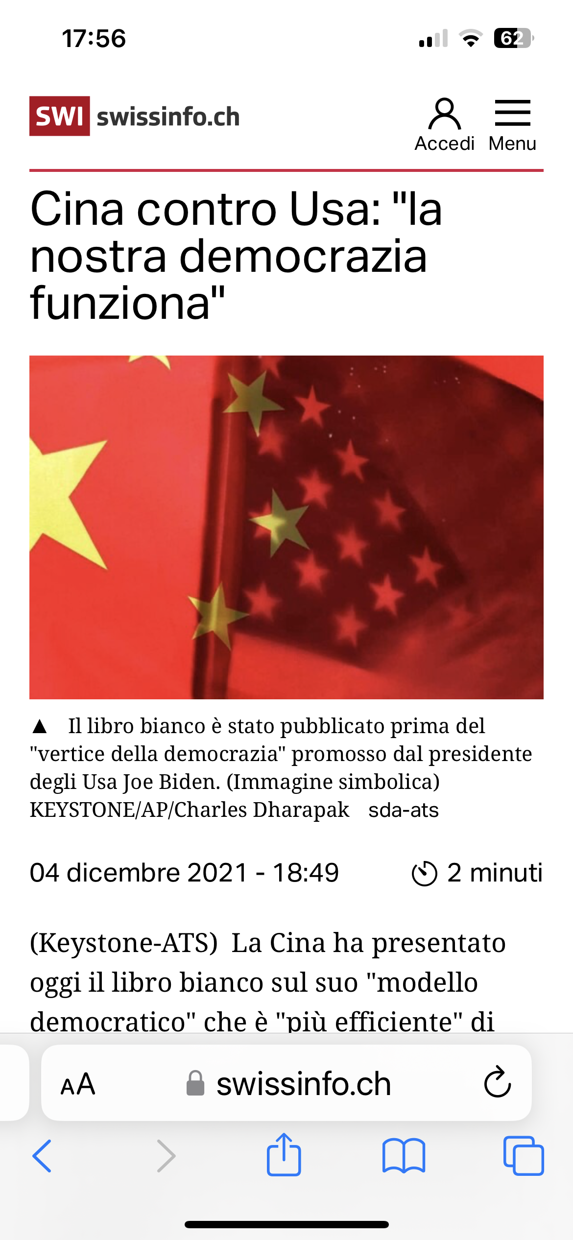
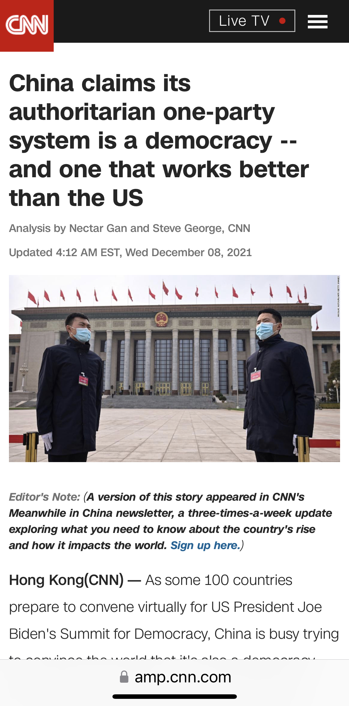
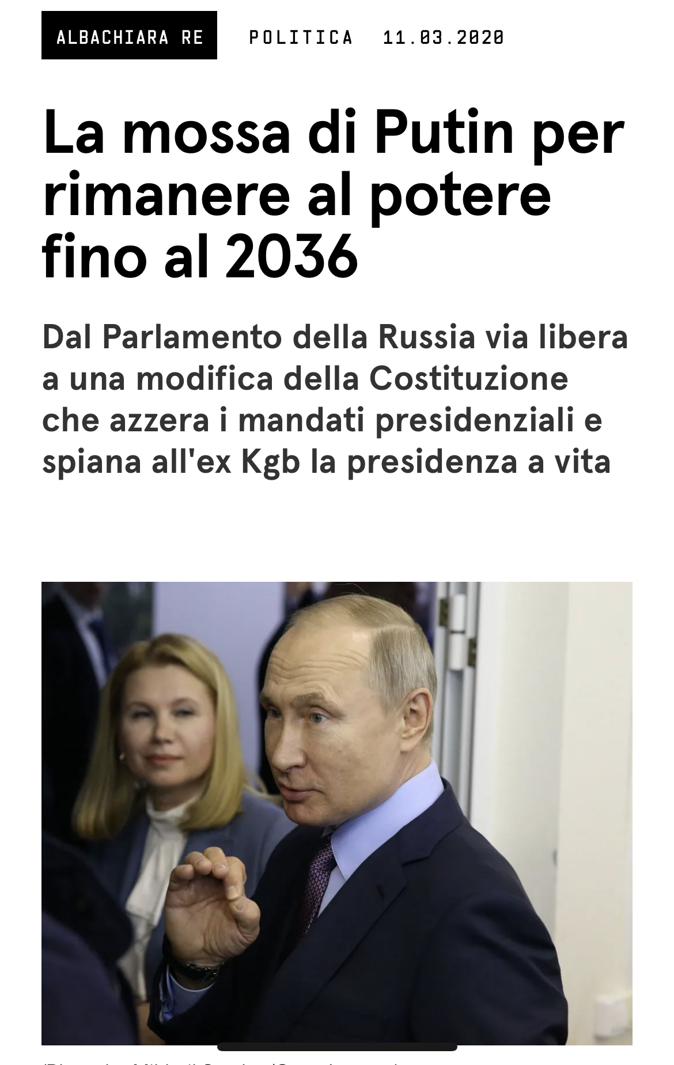
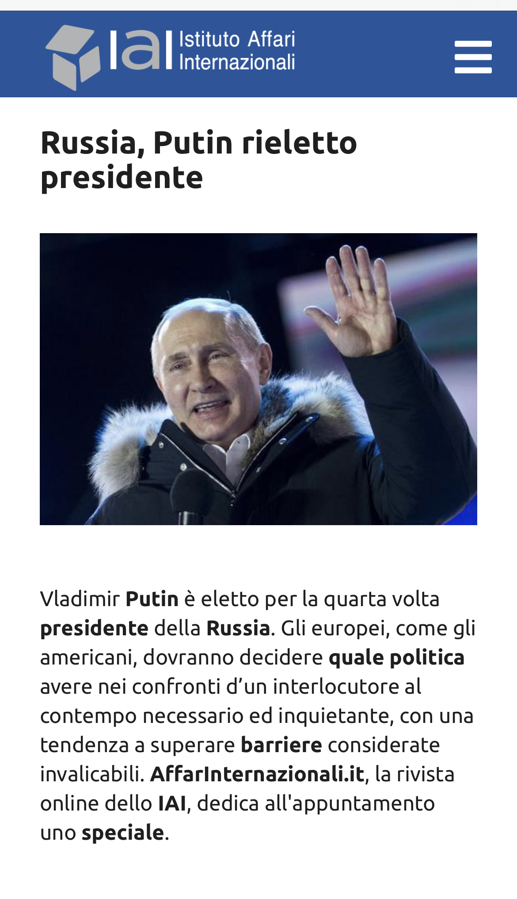
The democratic regime and its requirements

Slide 31
The democratic regime and its requirements - WHAT IS DEMOCRACY?
Democracy has a formal concept, referring to "the set of rules whose observance is necessary for political power to be effectively distributed among the majority of citizens", and another substantial one, linked to the idea of ​​equality (BOBBIO, Norberto. Liberalism and Democracy.)

Slide 32
Dimensions of democracy
Political democracy: deliberating, discussing and then making decisions
Social democracy
Economic democracy
Environmental democracy
Digital democracy

Slide 33
Theories of democracy
A look at the origins of democracy in Greece
Liberal Democracy – Freedom - Discourse on the freedom of the ancients compared to that of the moderns - Benjamin Constant
Pluralism (classical - Robert Dahl and radical - Chantal Mouffe) - Concern for electoral integrity
Participatory Democracy - Solidarity
Deliberative democracy - Discursive reason and solidarity

Slide 34
THEORIES OF DEMOCRACY AND ITS IMPORTANCE
Understanding the democratic reality
Critique of democratic reality
Help in drafting rules (theory - soft law - hard law - action plans for the defense of democracy)

Slide 35
The Copenhagen criteria and the enlargement of the European Union
The Treaty on European Union defines the conditions (Article 49) and principles (Article 6(1)) with which all countries wishing to become members of the European Union (Union) must comply.
To gain membership, you must meet some criteria. These criteria, known as the Copenhagen criteria, were established at the Copenhagen European Council in 1993 and strengthened at the Madrid European Council in 1995.
These criteria are:
the presence of stable institutions to guarantee democracy, the rule of law, human rights, respect and protection of minorities;
a reliable market economy and the ability to cope with market forces and competitive pressure within the Union; the ability to accept the obligations arising from membership, including the ability to effectively implement the rules, standards and policies that constitute the body of Union law (the acquis), as well as adherence to the objectives of the union political, economic and monetary. https://www.europarl.europa.eu/enlargement/ec/cop_en.htm

Slide 36
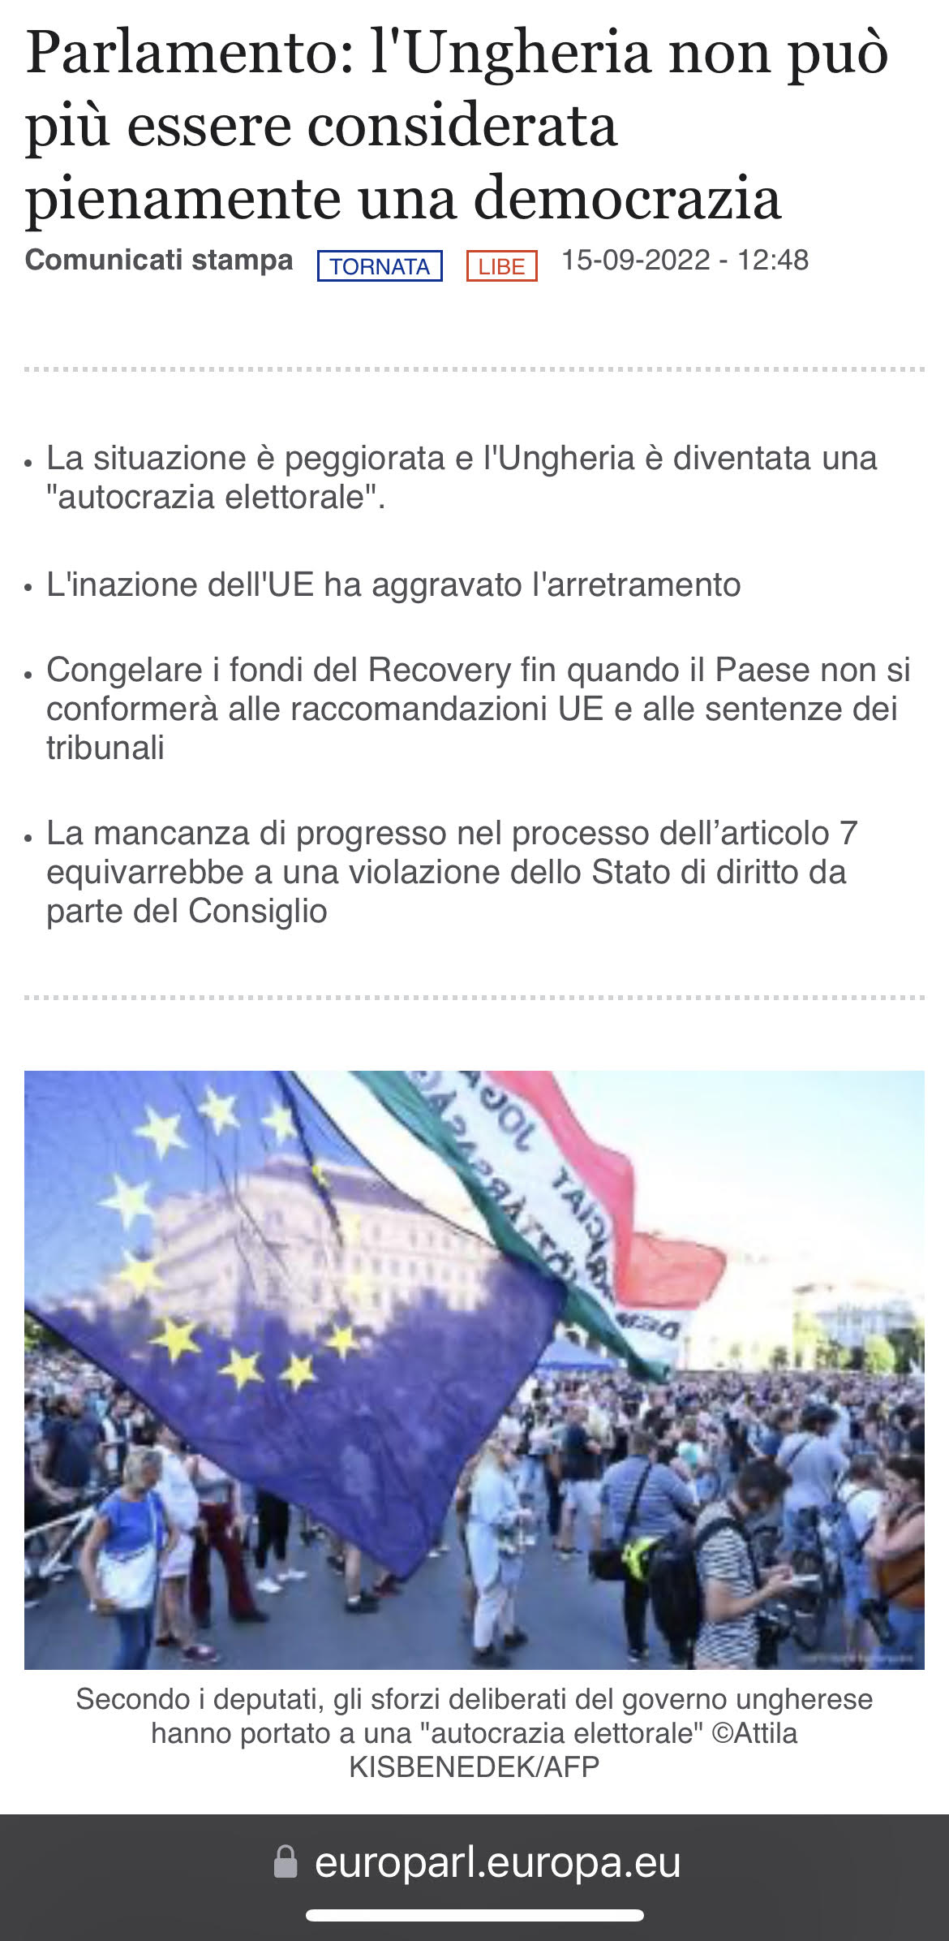
The enlargement of the European Union and democratic challenges Case C‑156/21 Hungary x European Parliament and Council of the European Union - Protection of the Union budget in the case of breaches of the principles of the rule of law in the Member States Case C‑204/21 European Commission X Republic of Poland - Independence of judges

Slide 37
Support for democracy in external relations (EU)
- Strategic framework on human rights and democracy and action plan for its implementation (2012) - https://www.consilium.europa.eu/uedocs/cms_data/docs/pressdata/en/foraff/131181.pdf
- Since the 2011 Arab uprisings, updating the European Neighborhood Policy, adopting an approach based on the principle of `more progress, more help’ 9 https://www.europarl.europa.eu/factsheets/en/sheet/170/the-european-neighbourhood-policy
- The EU's commitment to an empowered and resilient civil society, which is key to supporting good governance and the rule of law in every democracy.
- Possibility to suspend trade or cooperation if a country commits serious violations of human rights and democratic principles; a specific financing instrument aimed at supporting civil society actors in the field of democracy and human rights
- Election observation as a key tool available to the EU to support democratic development in third countries
https://www.europarl.europa.eu/factsheets/it/sheet/166/promotion-of-democracy-and-electoral-monitoring

Slide 38
Democracy as a criterion in international relations – Venezuela x Council of the European Union case
Case T‑65/18 RENV
the Council’s power to adopt restrictive measures falls within the sphere of independent measures of the Union adopted in the context of the CFSP, in accordance with the objectives and values of the Union as set out in Article 3(5) TEU and Article 21 TEU, namely (inter alia) the objective of promoting, in the wider world, democracy, the rule of law, the universality and indivisibility of human rights and fundamental freedoms, respect for human dignity, and respect for the principles of the United Nations Charter and international law. They are intended, inter alia, to ensure (i) fulfilment of the erga omnes partes obligations to respect the principles derived from general international law and international instruments of a universal or quasi-universal nature, in particular Article 1 of the United Nations Charter, (ii) respect for fundamental rights, in particular the prohibition of torture, (iii) respect for democratic principles and (iv) protection of the rights of the child. There is a common ‘legal interest’ in the rights in question being protected (see, to that effect and by analogy, Barcelona Traction, Light and Power Company, Limited, judgment, ICJ Reports 1970, p. 3, paras 33 and 34, and Questions relating to the Obligation to Prosecute or Extradite (Belgium v. Senegal), judgment, ICJ Reports 2012, p. 422, paras 68 to 70).
114 Accordingly, the arguments relied on by the Bolivarian Republic of Venezuela in that regard must be rejected.

Slide 39
Principle 10 of the RIO DECLARATION ON THE ENVIRONMENT AND DEVELOPMENT – 1992 - participatory and deliberative environmental democracy
The best way to face the environmental questions is to guarantee participation, in the appropriate way, in all interests. Nationally, the individual has access to all environmental information and has the authority of the publication, understands the information on its material pericolosi and takes action within the community, without the opportunity to participate in the decision-making process. Gli Stati facilitates and encourages awareness and public participation, making information available to everyone. It will guarantee effective access to meccanismi giudiziari and amministrativi, as much as it safeguards the risk and the risk of death.” – Principle 10 of the Dichiarazione di Rio sull'ambiente e lo sviluppo –
Source: http://portal.iphan.gov.br/uploads/ckfinder/arquivos/Carta%20do%20Rio%201992.pdf and https://www.isprambiente .gov.it/files/agenda21/1992-dichiarazione-rio.pdf

Slide 40
Aarhus Convention (signed in 1998 in Aarhus/Denmark and in force since 30 October 2001.) - recognition of the limits of environmental decision-making by public authorities.
Publication of decision 2005/370/CE of the Council concerning the conclusion, in the name of the European Community, of the Convention of Aarhus (17 February 2005). This Convention, which binds institutions and community bodies, brings applications to the European Union across the Regulation (EC) no. 1367/2006, I also note "Aarhus Regulation"
three pillars
access to all environmental information;
the public participation in all environmental decisions;
access to justice. (Slovak Brown Bear case (C-240/09)
This question is not just an environmental agreement; It is also an agreement regarding the responsibility, transparency and accessibility of the government.
Discipline for the promotion of environmental protection through procedural procedural steps, which is why I devote myself to the city and the environmental association
The both ways press the EU to approve the development of normative regulations for access to environmental matters (Aarhus regulation) - source: https://www.consilium.europa.eu/it/press/press-releases/2021/07 /23 /eu-ambassadors-endorse-update-to-legislation-on-access-to-justice-in-environmental-matters-aarhus-regulation/

Slide 41
Aarhus Convention (signed in 1998 in Aarhus/Denmark and in force since 30 October 2001.) - recognition of the limits of environmental decision-making by public authorities.
The Aarhus Convention’s twin protections for environmental and human rights, and its focus on involving the public, provide a mechanism for holding governments to account in their efforts to address the multi-dimensional challenges facing our world today, including climate change, biodiversity loss, poverty reduction, increasing energy demands, rapid urbanization, and air and water pollution…
Mr. Ban Ki Moon, former Secretary-General of the United Nations - https://unece.org/DAM/env/pp/Publications/Aarhus_Implementation_Guide_interactive_eng.pdf

Slide 42
The Future we want - Rio+20
17. We underscore that a fundamental prerequisite for the achievement of sustainable development is broad public participation in decision-making. Sustainable development requires major groups at all levels to play a meaningful role. It is important to enable all members of civil society to be actively engaged in sustainable development by incorporating their specific knowledge and practical know-how into national and local policy making. In this regard, we also acknowledge the role of national parliaments in furthering sustainable development.
18. We recognize that improved participation of civil society depends upon strengthening the right to access information and building civil society capacity to exercise this right. Technology is making it easier for Governments to share information with the public and for the public to hold decision makers accountable. In this regard, it is essential to work towards universal access to information and communications technologies.
(…)
20. We also acknowledge the essential role of local governments and the need to fully integrate them into all levels of decision making on sustainable development
Fonte: https://sustainabledevelopment.un.org/futurewewant.html

Slide 43
Escazú Agreement - Regional Agreement on Access to Information, Public Participation and Access to Justice in Environmental Affairs in Latin America and the Caribbean, adopted in Escazú (Costa Rica) on 4 March 2018
- First legally binding agreement resulting from the United Nations Conference on Sustainable Development (Rio+20),
- The first treaty on environmental issues in the region (Latin American and Caribbean countries)
- The first in the world to include provisions on environmental human rights defenders.
Source: https://repositorio.cepal.org/bitstream/handle/11362/43611/S1800493_pt.pdf

Slide 44
THE DEMOCRATIC REGIME AND ITS REQUIREMENTS
- inclusion of adults,
- equality of vote,
- effective participation of all members of the community - letting others know their opinion,
- enlightened understanding – knowing important alternative policies and their consequences
- control of the planning program

Slide 45
THE DEMOCRATIC REGIME AND ITS REQUIREMENTS
Freedom to form and join organizations
Freedom of expression
right to vote
Eligibility for public office
Right of political leaders to compete for support
Alternative sources of information
Free and fair elections
Institutions for making government policies dependent on votes and other expressions of preferences
PARTICIPATION + COMPETITION

Slide 46
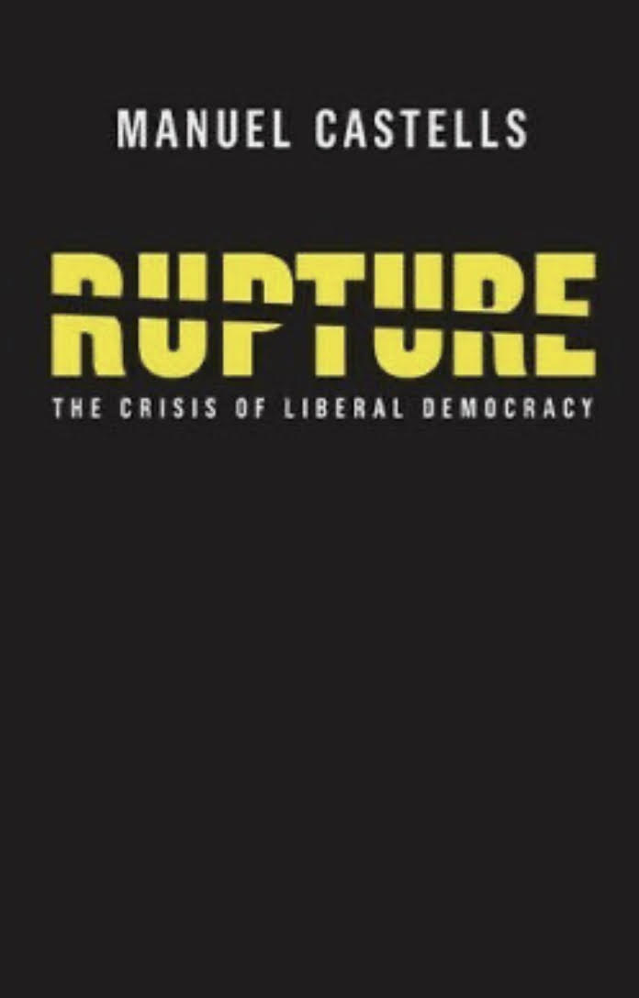
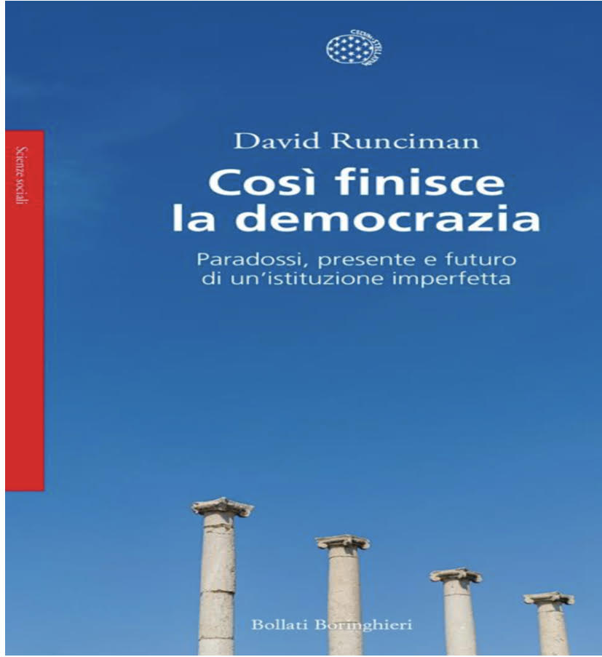
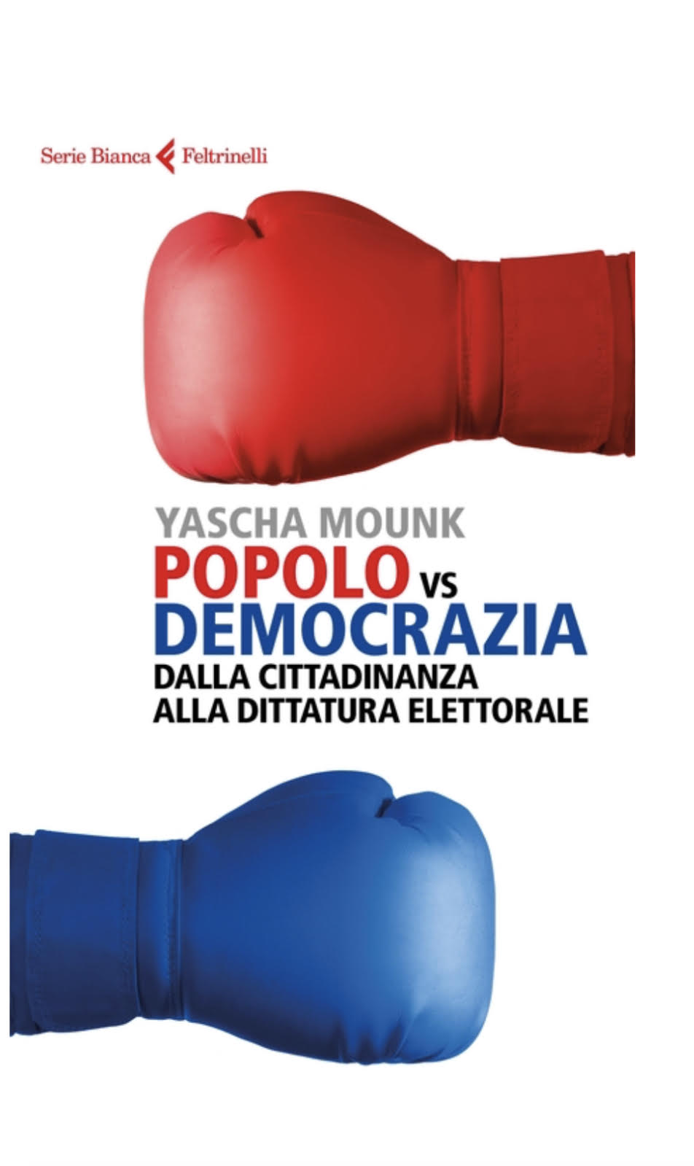
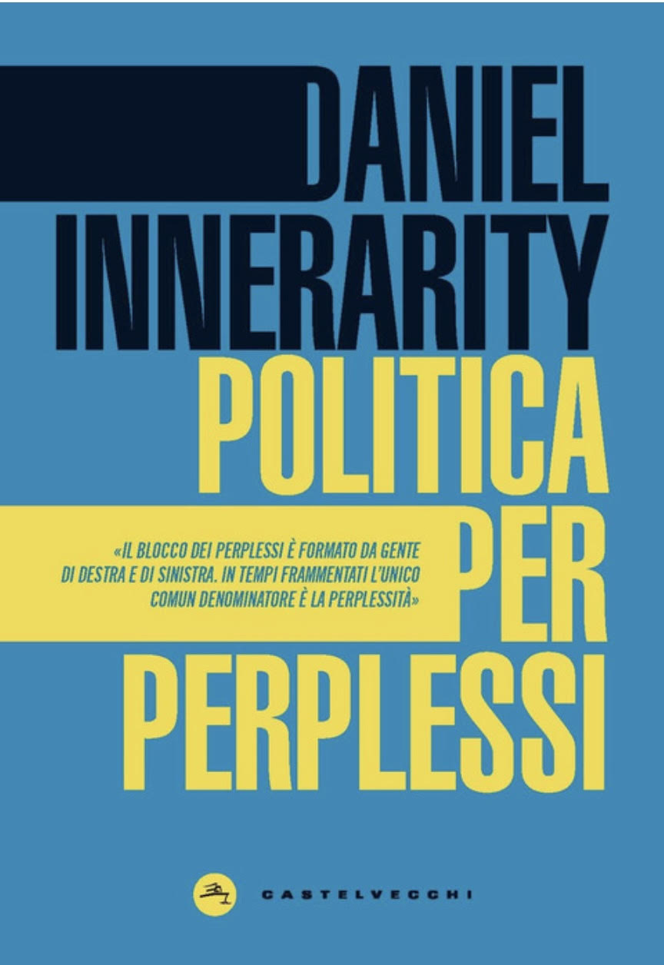
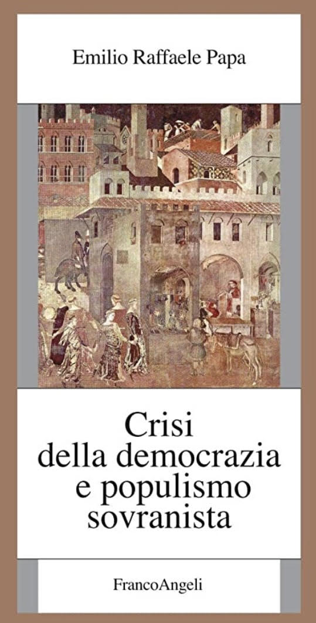
CRISIS OF DEMOCRACY

Slide 47
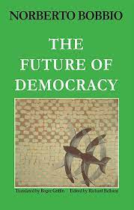
CRISIS OF DEMOCRACY
“For a democratic regime, being in transformation is its natural state: democracy is dynamic, despotism is static and always the same.”
BOBBIO, Norberto. The future of democracy: a defense of the rules of the game.

Slide 48
Permanent challenges of democracy and democratic crisis
Permanent challenges of democracy | Democratic crisis
massification of culture | Crisis of representativeness
Tyranny of the majority / (minority and vulnerable people) | Crisis of confidence in electoral integrity
Empty space of democracy and populism | Crisis resulting from civic apathy
Government inefficiency | Crisis of democratic dialogue/communicative frustration
Irrationality

Slide 49
CRISIS OF DEMOCRACY
Crisis of representativeness – In 2000, 65% of citizens did not trust political parties; in 2016 that number rose to 88%. As regards parliament, no confidence went from 39% to 77%. As for the government, it went from 39% to 77% (www.zahar.com.br/livro/ruptura)
Crisis of confidence in electoral integrity
Crisis resulting from civic apathy
Crisis of democratic dialogue/communicative frustration - hatred in democracy, lack of digital literacy, lack of respect for the phases of democratic debate, fake news, digital bubbles, unpreparedness to face new ways of carrying out electoral propaganda, neopopulism.

Slide 50
CRISIS OF DEMOCRACY
Fonte: https://www.avvenire.it/attualita/pagine/affluenza-elezioni-2022
https://www.corriere.it/politica/22_ottobre_05/elezioni-2022-la-prima-volta-1948-rappresentata-meno-meta-popolazione-546e5626-4488-11ed-b1df-7473c7dbd1a7.shtml

Slide 51
ACTION PLAN FOR EUROPEAN DEMOCRACY
Fonte: https://commission.europa.eu/strategy-and-policy/priorities-2019-2024/new-push-european-democracy/european-democracy-action-plan_it

Slide 52
Fair elections: Protecting the freedom and regularity of elections
legislation to ensure greater transparency in the area of sponsored political content (‘political advertising’), accompanied by support measures and guidance for political parties and Member States
the revision of the Regulation on the funding of European political parties
a new joint operational mechanism for electoral resilience through the European Cooperation Network on Elections. This is to build capacity in Member States to address risks to elections, in particular on disinformation and cyber-related threats, in close cooperation with the NIS (security of information systems) Cooperation Group.

Slide 53
Funding for democracy
promoting election integrity, boosting citizen participation, civic engagement and trust in democracy, through funding from the Citizens, Equality, Rights and Values programme; Creative Europe; Erasmus+; and Horizon Europe, Cohesion funds
strengthening funding to news media organisations within the EU and beyond, through funding from Creative Europe; Digital Europe; Global Europe Human Rights and Democracy Programme
fighting disinformation with the view to promoting media literacy and helping citizens identify disinformation through funding from Erasmus+ and the European Solidarity Corps

Slide 54
European media freedom act
On 16 September 2022, the European Commission adopted the European Media Freedom Act, a new set of rules to protect media pluralism and independence in the EU.
The European Media Freedom Law will ensure that media, both public and private, can operate more easily across borders in the EU internal market, without undue pressure. It will also take into account the digital transformation of the media space.
The Commission also proposed to establish an independent European Media Services Board, made up of national media regulators. The Board will promote the effective and consistent application of EU media rules, in particular by publishing guidance on regulatory issues in the sector
https://ec.europa.eu/commission/presscorner/detail/en/ip_22_5504.

Slide 55
Media freedom and pluralism
On 27 April 2022, the European Commission launched actions to improve the protection of journalists and human rights defenders from abusive judicial proceedings. Strategic lawsuits aimed at blocking public participation, commonly known as gag actions or "SLAPP" (strategic lawsuits against public participation), are a particular form of harassment used mainly against journalists and human rights defenders to prevent or penalize possibility to intervene on matters of public interest.
The proposed directive concerns SLAPPs in civil matters with cross-border implications. It allows judges to quickly dismiss manifestly unfounded lawsuits against journalists and human rights defenders. It also establishes various procedural guarantees and remedies, such as compensation for damages, and dissuasive sanctions for initiating abusive legal actions.
At the same time, the Commission also adopted a complementary recommendation to encourage Member States to align their rules with proposed EU law for national cases and in all proceedings, not just in civil matters. The recommendation also calls on Member States to take a number of other measures, such as training and awareness-raising, to combat gag actions.

Slide 56
Fight against disinformation
Democracies around the world are witnessing the proliferation of false information, which could destabilize their democratic institutions and undermine citizens' trust. Addressing misinformation, disinformation and foreign interference requires several strategic responses.
The Action Plan for European Democracy sets out a comprehensive response, based on the work done by the EU and firmly anchored in European values ​​and principles. Safeguards freedom of expression and people's right to access legal content.
To step up the fight against disinformation, the Commission intends to:
improve the toolkit available to the EU to counter foreign interference in our information space, integrating new tools that allow it to impose costs on those responsible
Channel efforts to reform the Code of Practice on Disinformation towards a co-regulatory framework for the obligations and liability of online platforms, in line with the forthcoming Digital Services Act
publish guidance to improve the code of practice in spring 2021 and establish a more robust framework to monitor its implementation.

Slide 57
Elections and contemporary challenges
“Healthy democracy relies on open, free and fair public debate. It's our duty to protect this space and not allow anybody to spread disinformation that fuels hatred, division, and mistrust in democracy. As the European Union, we've decided to act together and reinforce our response, to promote our principles, to support the resilience of our societies, within our borders and in the neighbourhood. It's the European way to respond to one of the main challenges of our times." Federica Mogherini - High Representative/Vice President 2014-2019 - https://ec.europa.eu/commission/presscorner/detail/en/IP_18_6647

Slide 58
Elections and contemporary challenges
“I am disappointed to see that Twitter report lags behind others and I expect a more serious commitment to their obligations stemming from the Code,” the EU’s Vice President for Values and Transparency Věra Jourová said in a statement.

Slide 59
ELECTIONS AND CONTEMPORARY CHALLENGES
Action plan against disinformation. (Ensure more effective detection, Formulate a coordinated response, Online platforms and services, Raise awareness and empower citizens)
Code of Practice on Disinformation (strengthened in 2022 - https://digital-strategy.ec.europa.eu/it/policies/code-practice-disinformation)
Annual self-assessment reports submitted by Facebook, Google, Microsoft, Mozilla, Twitter and 7 European associations under the Code of Conduct on Disinformation.
Special Committee on foreign interference in all democratic processes in the European Union, including disinformation, and on strengthening integrity, transparency and accountability in the European Parliament« https://www.europarl.europa.eu/doceo/document /TA-9-2023-0030_PT.html

Slide 60
Elections and contemporary challenges - Special Committee on foreign interference in all democratic processes in the European Union, including disinformation, and on strengthening integrity, transparency and accountability in the European Parliament
The European Parliament
A. A. whereas foreign interference constitutes a serious violation of the universal values and principles on which the EU is founded, such as human dignity, freedom, equality, solidarity, respect for human rights and fundamental freedoms, democracy and the rule of law; whereas evidence shows that malicious and authoritarian foreign state and non-state actors are using information manipulation and other tactics to interfere in democratic processes in the EU; whereas such attacks mislead and deceive citizens and affect their voting behaviour, amplify divisive debates, divide, polarise, and exploit the vulnerabilities of, societies, promote hate speech, worsen the situation of vulnerable groups which are more likely to become victims of disinformation, distort the integrity of democratic elections and referendums, sow distrust in national governments, public authorities and the liberal democratic order and have the goal of destabilising European democracy;
B. whereas a campaign of disinformation of an unparalleled malice and magnitude with the purpose of deceiving both domestic citizens and the international community of States as a whole has been carried out by Russia since the eve of and during its war of aggression against Ukraine started on 24 February 2022;
C. whereas attempts by state actors from third countries and non-state actors to interfere in the functioning of democracy in the EU and its Member States, and put pressure on the values enshrined in Article 2 of the Treaty on the European Union by means of malicious interference, are part of a wider disruptive trend experienced by democracies worldwide;
(…) Decides that the special committee shall henceforth be named ‘special committee on foreign interference in all democratic processes in the European Union, including disinformation, and the strengthening of integrity, transparency and accountability in the European Parliament’ … https://www.europarl.europa.eu/doceo/document/TA-9-2023-0030_EN.html

Slide 61
EUROPEAN DEFENCE OF DEMOCRACY PACKAGE
A recent Eurobarometer survey shows that 81% of Europeans believe that foreign interference in our democratic systems is a serious problem that needs to be addressed. It is high time to bring covert foreign influence to light.
The central piece of this package is a legislative proposal that will
enhance transparency and democratic accountability of interest representation activities on behalf of third countries which are aimed at influencing policies, decision making and the democratic space.
It also includes two recommendations which aim to promote free, fair and resilient elections and
the participation of citizens and civil society organisations to policy-making.
https://ec.europa.eu/commission/presscorner/detail/en/ip_23_6453

Slide 62
VALUE OF DEMOCRACY
The best bet for most people, without disparaging minorities and human dignity
The tendency to hold leaders accountable
The preservation of peace
Legitimacy
Maximization of well-being

Slide 63
CRISIS OF DEMOCRACY AND ITS REVITALISATION
“Learning to live in chaos is perhaps not as harmful as conforming to the discipline of an order” Rupture: the crisis of liberal democracy, Manuel Castells, Zahar, 2018, p. 148.
Greater citizen participation with education and tolerance
Improvement of representative democracy with rapprochement between representatives and represented and strengthening of institutions
Improving participatory democracy (fighting apathy and contempt for politics)

Slide 64
Participatory and environmental democracy and democratic crisis - context and proposal
In the midst of the democratic crisis and the current peace crisis, the defense of the right to information, participation and access to justice for the protection of the environment may seem, at the same time, ineffective.
However, the defense of democracy and the environment are at the center of the efforts that must be carried out jointly by countries.
Furthermore, the defense of democracy and the environment is made up not only of large struggles, but of small and continuous struggles, by everyone. This idea, among other things, integrates the concept of political and environmental democratic solidarity.
Even if we are under material, social, economic and legal rubble, fighting for the integrity of every brick that makes up the construction of our house - our planet, with its complexities and institutions - is what will allow us to save and preserve something for the present and for future generations.

Slide 65
CRISIS OF DEMOCRACY/VALUE OF DEMOCRACY
Democracy can be criticized as bringing social instability and making debate on simple issues complex, but we must consider that it is the only regime capable of ensuring freedom. Ian Shapiro, among other things, makes an interesting reflection when he points out that:
“Democracy is a system in which those who are harmed by existing agreements at a given time have both the incentive and the means to point out the flaws in those agreements, demonstrate how the truth about them is being hidden, and seek to change those agreements .»
He also believes that if democratic dispute cannot be considered a cure for society, it is certainly an essential remedy for the chronic disease of constant attack on freedom and truth. SHAPIRO, Ian. Moral foundations of politics.

Slide 66
DEMOCRACY AND RULE OF LAW IN INTERNATIONAL RELATIONS
Universal declarations of rights recognizing the importance of the people for representation (for citizens – usually men)
Declarations of rights recognizing the importance of political rights for all human beings who participate in political life in society – relationship between political rights and human rights
Use of democracy as a condition for the expansion of Europe and regional declarations assuming democracy as the regime that most fulfills fundamental rights
Universal declarations (soft low) and actions recognizing the importance of democracy in its relationship with fundamental rights, international conventions and agreements recognizing the importance of participatory democracy in defending the environment (Arrhus Convention and Escazu Agreement)
Regional actions between countries to promote democracy and a plan to defend democracy (recognizing that, even without wars, third countries can interfere in the internal democracy of each country, therefore requiring an effort and an agreement between countries to defend democracy)

Slide 67
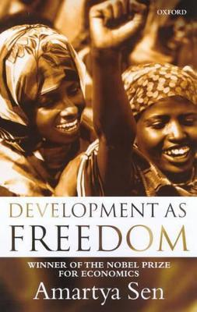
CRISIS OF DEMOCRACY/VALUE OF DEMOCRACY
Developing and strengthening a democratic system is an essential component of the process of development. The significance of democracy lies, I have argued, in three distinct virtues: (I) its intrinsic importance, ( 2) its instrumental contributions, and ( 3 ) its con­structive role in the creation of values and norms. DEVELOPMENT AS FREEDOM, Amartya Sen, chapter 6

Slide 68
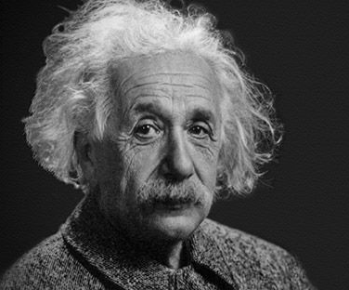
CRISIS OF DEMOCRACY/VALUE OF DEMOCRACY
My political ideal is democracy. Let every man be respected as an individual and let no one be idolized." Albert Einstein - Book The world as I see it
https://history.aip.org/exhibits/einstein/essay_text.htm

