Slide 1
Winter School Reinforcing EU responsible global leadership Promoting EU values for a rules-based multilateral world
Upholding and promoting Human Rights in wider world through EU international agreements
Professor Francesca Martines
6 February 2024, Pisa, Italy

Slide 2
OUTLINE
Part I: Eu as a World actor in promoting HR
Part II: HR as limits to action
Part III: HR protection

Slide 3
Questions
Part I:
- How can the EU have an impact on the protection of human rights outside Europe?
- What tools can it use?
- What are the place of HR in the context of values it promotes?
Part II
When concluding international agreements, what limits do human rights obligations impose on the EU?
Part III
What mechanisms does it include in trade and cooperation agreement to enhance HR protection in third countries?

Slide 4
PART I EU as a World Actor (in promoting HR)

Slide 5
What is the European Union?
International organisation
Market
Legal order

Slide 6
International Organisation: EU action limited
Principle of conferral (article 5 TEU)
1. The limits of Union competences are governed by the principle of conferral. ....
2. Under the principle of conferral, the Union shall act only within the limits of the competences conferred upon it by the Member States in the Treaties to attain the objectives set out therein. Competences not conferred upon the Union in the Treaties remain with the Member States.

Slide 7
World Actor – Fields of external competence
External fields: commercial policy – development cooperation – humanitarian aid – foreign policy
External/internal: environmental protection
Internal with external impact: internal market

Slide 8
Tools
LEGAL TOOLS
International agreements in all fields of external competence / in fields of internal competence (case-law of the ECJ)
Unilateral measures in all fields of competence when it has the power to regulate

Slide 9
Trade policy
Article 206 TFEU (objectives)
.. the Union shall contribute, in the common interest, to the harmonious development of world trade, the progressive abolition of restrictions on international trade and on foreign direct investment, and the lowering of customs and other barriers.

Slide 10
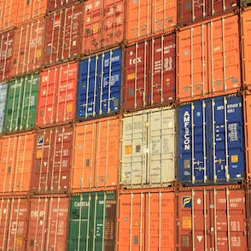
Article 207 TFEU Common commercial policy
1. The common commercial policy shall be based on uniform principles, particularly with regard to changes in tariff rates, the conclusion of tariff and trade agreements relating to trade in goods and services, and the commercial aspects of intellectual property, foreign direct investment, the achievement of uniformity in measures of liberalisation, export policy and measures to protect trade such as those to be taken in the event of dumping or subsidies. The common commercial policy shall be conducted in the context of the principles and objectives of the Union's external action

Slide 11
EU Trade agreements

Slide 12
WORLD Actor ?
POWER:
IMPACT on distribution of resources
IMPACT on defining values
SHAPING rules
Autonomy

Slide 13
What Human rights? Context
article 2 TEU – identity values
Article 3.5 TEU (EU external mission)

Slide 14
Article 3.5 TEU
In its relations with the wider world, the Union shall uphold and promote its values and interests and contribute to the protection of its citizens. It shall contribute to peace, security, the sustainable development of the Earth, solidarity and mutual respect among peoples, free and fair trade, eradication of poverty and the protection of human rights, in particular the rights of the child, as well as to the strict observance and the development of international law, including respect for the principles of the United Nations Charter

Slide 15
What HR?
human rights are indivisible and universal. There is no space given to cultural, ethnic or religious relativism. Human rights in the clause extend to political, social, cultural, economic, labour, minority rights

Slide 16
Values and interests
dichotomy?
Migration / international law // non refoulement principle // push-back // Frontex // Turkey – HR
Stability in Tunisia // financial aid // and the rule of law...

Slide 17
Labour conditions
Interests of the EU in relationships with third countries: labour conditions but «level playing field» Labour condition way to offset social dumping and unfair competition for European industries the interest for the donor of having a stable and democratic neighbour country, of enlarging its market, increasing its international influence

Slide 18
Mandate to promote values
TEU
GENERAL PROVISIONS ON THE UNION'S EXTERNAL ACTION
Article 21
1. The Union's action on the international scene shall be guided by the principles which have inspired its own creation, development and enlargement, and which it seeks to advance in the wider world: democracy, the rule of law, the universality and indivisibility of human rights and fundamental freedoms, respect for human dignity, the principles of equality and solidarity, and respect for the principles of the United Nations Charter and international law.

Slide 19
To sum-up
The European Union has limits to its action because of the principle of the allocation of competences (which are however expanding), but it still has important competences that allow it to interact with third countries in crucial sectors and to participate in the definition of international trade rules. It is a huge and very attractive market for any company or business wishing to sell its goods or services in the Union.
Main tools: international agreements – it has an extensive network of agreements
HR as part of EU values

Slide 20
Part II
HR as Limits to Action

Slide 21
Values and action
Values / HR protection
- must guide Union’s (external) action
- set limits to that action

Slide 22
When concluding international agreements, what limits do human rights obligations impose on the EU?
EU shall avoid HR violations when concluding treaties

Slide 23
Trade agreement and HR violation
How can the conclusion of an agreement affect HR?
- No cause effect relationship
- Varieties of causes and situations

Slide 24
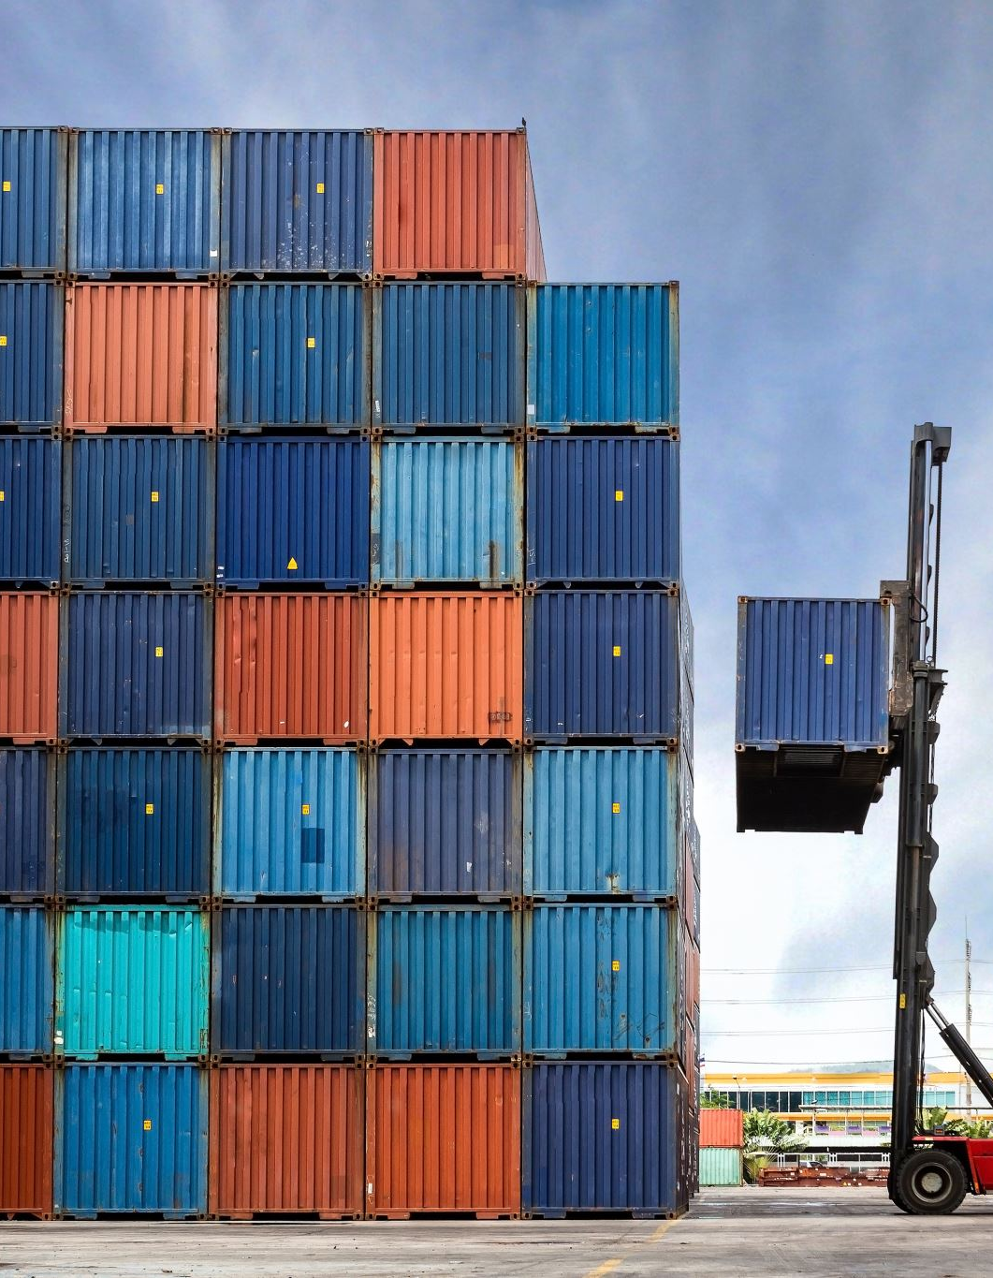
Trade and HR - examples
export of labour-intensive goods //indirectly encourage child labour in a situation of low labour standards.
exports of certain agricultural goods //communities vulnerable to food insecurity;
increased exports of water- (and land-) intensive industries (such as beef) // access to water ;
regulation of patents on traditional knowledge /// cultural heritage and traditional knowledge of indigenous peoples. //increase medicine prices.
decrease in tax revenues due to the reduction of customs duties ///redistributive measures in developing countries.

Slide 25
EU obligations
Due diligence : try to prevent the occurrence of a given situation
How?

Slide 26
Impact assessment
identification of problems and objectives
development of policy options
stakeholder consultation
data collection

Slide 27
EU- Vietnam Free Trade Agreement
The Ombudsman noted that the principles set out in Article 21(1) TEU and Article 21(2) TEU apply also in the area of the common commercial policy.
Although the Ombudsman agreed with the Commission that there appears to be no express and specific legally binding requirement to carry out a human rights impact assessment concerning the relevant free trade agreement, she took the view that it would be in conformity with the spirit of the legal provisions mentioned above to carry out a human rights impact assessment.
Since the 2009 sustainability impact assessment concerning ASEAN covers only certain aspects of the impact on social rights, it is not a proper substitute for a human rights impact assessment

Slide 28
Part III EU action to protect Human Rights in the rest of the World

Slide 29
HOW?
CONDITIONALITY

Slide 30
External conditionality
Donor recipient behavior advantage

Slide 31
Conditionality
EU
grants advantage (POSITIVE C.)
withdraws benefit (NEGATIVE C.) (COST)
made contingent upon a pre-defined behavior by another subject (STATE)

Slide 32
Behaviour required
positive, that is the recipient is required to act in a specific manner: for example, accede to a specific agreement, readmit illegal migrants
negative when it is required to abstain from a conduct: not to make reservations to a specific agreement.

Slide 33
RATIONALE CONDITIONALITY
leverage mechanism to orientate behavior:
‘pro-social behavior is rewarded and anti-social behavior is punished

Slide 34
positive conditionality:
tariff preferential access into the EU market for some products originating from developing countries
The GSP plus : reward mechanism : further tariff concessions provided that the recipient State satisfies a number of conditions

Slide 35
GSP – positive conditionality
List of convention in an annex to the regulation
HR conventions – ILO conventions on labour rights
Cartagena Protocol on biodiversity Kyoto Protocol
Good governance

Slide 36
negative conditionality
Temporary withdrawal of preferences
in case of serious and systematic violations of principles laid down in core human and labour rights conventions.

Slide 37
HR Clauses
1995 the European Community established a policy of systematically including such clauses in all its trade and cooperation agreements
No NEW standards - reaffirmation of obligations

Slide 38
Human rights clause
Respect for human rights, (democratic principles, rule of law, good governance) is defined as an ‘essential element’ of the agreement.
Non-execution clause, which provides for a reaction in the hypothesis of a violation of an essential element of the Agreement – “appropriate measures” – suspension of the agreement

Slide 39
Cotonou (ACP countries)
“Respect for human rights, democratic principles and the rule of law, which underpin the ACP–EU Partnership, shall underpin the domestic and international policies of the Parties and constitute the essential elements of this Agreement”
(Cotonou Agreement with ACP countries, Article 9(2))

Slide 40
Ex. Korea: Essential element clause in the framework agreement
The Parties confirm their attachment to democratic principles, human rights and fundamental freedoms, and the rule of law. Respect for democratic principles and human rights and fundamental freedoms as laid down in the Universal Declaration of Human Rights and other relevant international human rights instruments, which reflect the principle of the rule of law, underpins the internal and international policies of both Parties and constitutes an essential element of this Agreement.
(reference to international law)

Slide 41
Linkage clause
Trade agreement with Korea no HRC BUT it contains LINKAGE CLAUSE:
Article 2. The present (TRADE) Agreement shall be an integral part of the overall bilateral relations as governed by the Framework Agreement. It constitutes a specific Agreement giving effect to the trade provisions within the meaning of the Framework Agreement'.

Slide 42
Examples
GEORGIA
Respect for the democratic principles, human rights and fundamental freedoms, as proclaimed in the United Nations Universal Declaration of Human Rights of 1948 and as defined in the European Convention for the Protection of Human Rights and Fundamental Freedoms of 1950, the Helsinki Final Act of 1975 of the Conference on Security and Cooperation in Europe and the Charter of Paris for a New Europe of 1990 shall form the basis of the domestic and external policies of the Parties and constitutes an essential element of this Agreement
Countering the proliferation of weapons of mass destruction, related materials and their means of delivery also constitute essential elements of this Agreement”.

Slide 43
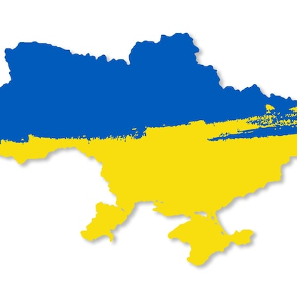
Example: UKRAINE
ADD: ‘Promotion of respect for the principles of sovereignty and territorial integrity, inviolability of borders and independence as well as countering the proliferation of weapons of mass destruction.’

Slide 44
Definition of HR: interpretation of the human rights clause during the negotiations
Singapore opposed the inclusion of the clause in the Partnership and Cooperation Agreement (ESPCA) because it feared that this could affect its legislation on the death penalty.
Compromise: the parties signed a side letter to the ESPCA declaring that:
‘neither party are aware (…) of any of each other’s domestic laws, or their application, which could lead to the invocation of the non-execution mechanism. Both sides confirm their understanding that ..... they are not aware of any of each other's domestic laws, or their application, which could lead to the invocation of Article 44 of the Agreement”
This is a recognition made in advance by Singapore that it complies with the human rights clause and that the EU will not challenge this.
This compromising solution is of concern because it in this way the EU is explicitly accepting that the human rights protection standards in Singapore are the same as the level of protection of human rights in the EU.

Slide 45
Non-execution clause
included in the final dispositions of the agreement
adoption of 'appropriate measures' in the case of violation of an essential element.
Standard ’appropriate measures' should be in line with international law and proportionate to the gravity of the violation.
The suspension of an agreement: measure of last resort.
Priority to measures that least disrupt the application of an agreement.
consultations in the joint oversight body - Association Council.
arbitration procedure (as in the case of the agreement with Korea in 2010), regular dispute settlement mechanism (as in the case of the agreements with Georgia and Moldova from 2013)

Slide 46
Canada
Non-execution clause 'a particularly serious and substantial
violation of human rights or non-proliferation, as defined in paragraph 3, could also serve as grounds for the termination of the EU-Canada Comprehensive Economic and Trade Agreement
for a situation to constitute a ''particularly serious and substantial violation'' of Article 2(1), its gravity and nature would have to be of an exceptional sort such as a coup d'État or grave crimes that threaten the peace, security and well-being of the international community' (Article 28.3).

Slide 47
EU practice HR Clauses
incorporation of the clause into EU agreements
decision to make it a qualifying element of the relationship,
scope of the clause
linkage with enforcement mechanisms

Slide 48
Limits of HR clauses
Broad discretionary power of the institutions (Mugraby Case C-581/11)
the applicant criticised the Council and the Commission for having failed to suspend the Association Agreement as provided for in Article 86 (conclusions upheld by the ECJ).
Consent of EU Partners
Changing environment – in comparison with China less emphasis on HR leverage so the developing countries have acquired more leverage

Slide 49
Positive actions to be preferred
Dialogue
Positive incentives

Slide 50
How to improve?
Consistency
Reinforce dialogue before and during negotiations
Road map for HR compliance
Monitoring and Compliance mechanism by the civil society

Slide 51
Other ways of affecting HR through agreements
Data privacy
Sustainable development

Slide 52
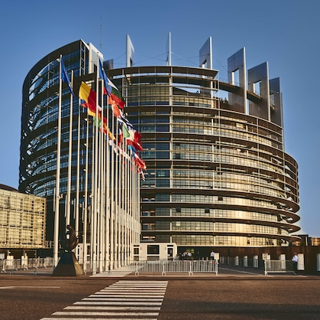
“Brussels effect” (Anu Bradford)
regulations that shape the international business environment,
standards worldwide,
Europeanization of many important aspects of global commerce:
data privacy, consumer health and safety, environmental protection, antitrust

Slide 53
Example: Data Privacy
cross-border data flows - expansion of international trade;
“personal data” to be protected
State of destination : less protection
Agreements:
promoting data transfers
counterbalanced
safeguard the rights to privacy and to the protection of personal data

Slide 54
Sustainable development
Article 3.5 TEU
..It shall contribute to peace, security, the sustainable development of the Earth...”
Article 11 TFEU
Environmental protection requirements must be integrated into the definition and implementation of the Union's policies and activities, in particular with a view to promoting sustainable development
(EU Charter of HR) article 37 (similar to article 11)

Slide 55
Cross-cutting obligation
contributing to the sustainable development of third countries, in particular developing countries, is an obligation for all external action of the EU development cooperation policy, and in other areas of external action, including trade policy

Slide 56
Material content of sustainable development
social protection of workers, with reference to issues such as freedom of association and the effective recognition of the right to collective bargaining, the elimination of all forms of forced labour, the effective abolition of child labour, and the elimination of discrimination in employment
environmental protection and sustainable management of natural resources, with particular reference to timber, fish stocks and natural resource conservation measures, must be included in this broad notion of sustainable development
sustainable development is an integral part of the objectives of the common trade policy

Slide 57
TSD Chapters in EU Trade Agreements
chapter on sustainable development promoting the effective implementation of multilateral labour and environmental agreements to which the EU and its partner are parties.
Promoting ratification of other labour and environmental protection conventions is not excluded, as specified, (Free Trade Agreement with Korea)

Slide 58
TDS Monitoring:
Committee on Trade and Sustainable Development overseeing the implementation of the TSD chapter.
Domestic Advisory Group(s) on sustainable development (environment and labour) - composed of independent representative organisations of civil society in the fields of environment, labour and business - with the task of advising on the implementation of the TSD Chapter.
The Members of Domestic Advisory Group(s) of each Party meet at a Civil Society Forum to conduct a dialogue encompassing sustainable development aspects of trade relations between the Parties.
If the government to government consultations has not led to satisfactory results, a Panel of experts may be convened

Slide 59
Panel EU- South Korea. – 25.01.2021
Korea has not acted consistently with its obligations.
Korea has to modify its legislation and labour practicw and continue the process of four ILO conventions to conform to its obligation under. The free trade agreement

