Slide 1
Latin American and European Common Fundamental Values
PROF. MARCELO LABANCA
UNIVERSIDADE CATÓLICA DE PERNAMBUCO – BRASIL
MARCELOLABANCA@OUTLOOK.COM

Slide 2
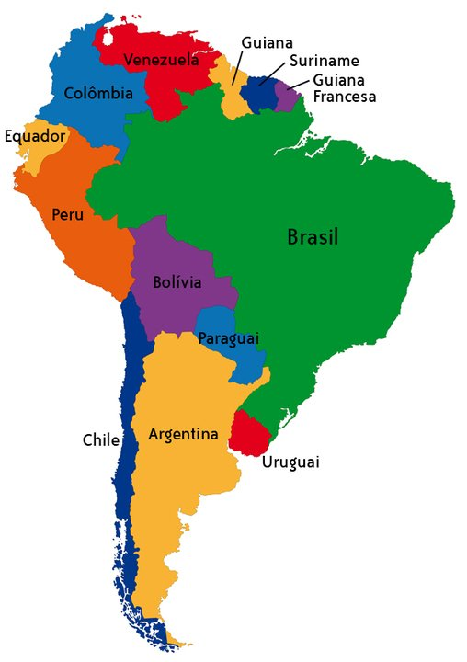
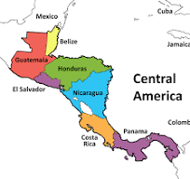
Latin américa and rights – MULTILEVEL SYSTEM
SUBNACIONAL RIGHTS
NATIONAL LEVEL
INTERNATIONAL

Slide 3
Values: Human dignity
Argentina: acceso a una vivienda digna (art. 14)
Brasil: a dignidade da pessoa humana (art. 1)
Colombia: respeto de la dignidad humana / La honra, la dignidad y la intimidad de la familia son inviolables(art.1;art.2)
Venezuela: desarrollo de la persona y el respeto a su dignidad (art. 3)
El Salvador: La ley no puede autorizar ningún acto o contrato que implique la pérdida o el irreparable sacrificio de la libertad o dignidad de la persona (art. 10)

Slide 4
AMERICAN CONVENTION ON HUMAN RIGHTS
Article 5. Right to Humane Treatment
1. Every person has the right to have his physical, mental, and moral integrity respected.
2. No one shall be subjected to torture or to cruel, inhuman, or degrading punishment or treatment. All persons deprived of their liberty shall be treated with respect for the inherent dignity of the human person.
Article 11. Right to Privacy and dignity
1. Everyone has the right to have his honor respected and his dignity recognized.

Slide 5
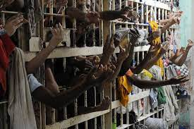
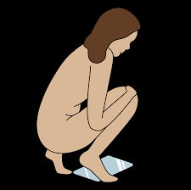
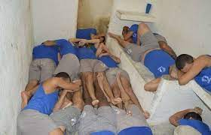
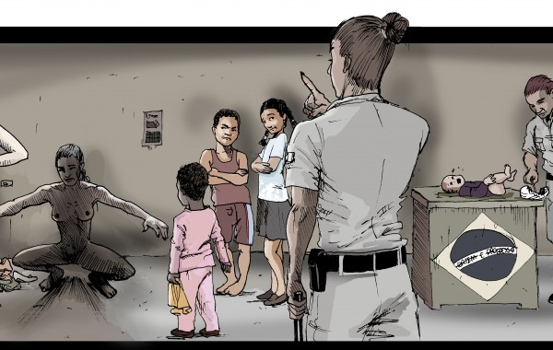
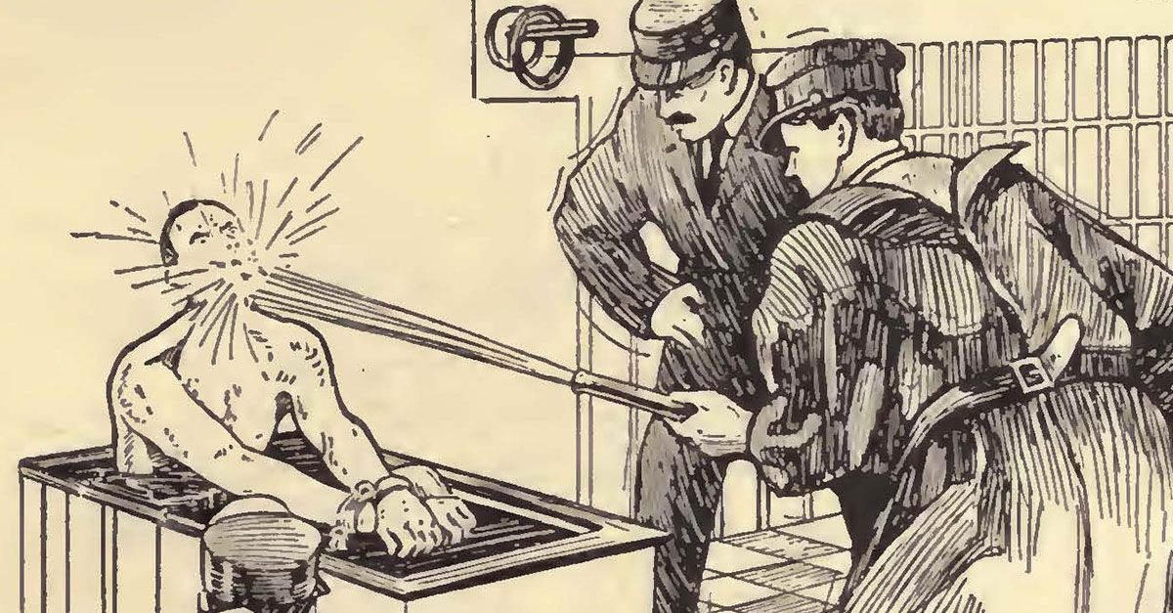
VIOLATIONS

Slide 6
Values: freedom
Freedom of, v.g.:
thought
religion
Assembly
expression
information

Slide 7
Article 12. Freedom of Conscience and Religion
1. Everyone has the right to freedom of conscience and of religion. This right includes freedom to maintain or to change one's religion or beliefs, and freedom to profess or disseminate one's religion or beliefs, either individually or together with others, in public or in private.
Article 13. Freedom of Thought and Expression
1. Everyone has the right to freedom of thought and expression. This right includes freedom to seek, receive, and impart information and ideas of all kinds, regardless of frontiers, either orally, in writing, in print, in the form of art, or through any other medium of one's choice.

Slide 8
Article 15. Right of Assembly
The right of peaceful assembly, without arms, is recognized.
Article 16. Freedom of Association
1. Everyone has the right to associate freely for ideological, religious, political, economic, labor, social, cultural, sports, or other purposes.
Article 22. Freedom of Movement and Residence
1. Every person lawfully in the territory of a State Party has the right to move about in it, and to reside in it subject to the provisions of the law.

Slide 9
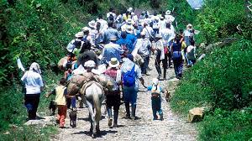
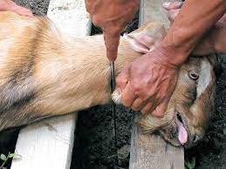
Desplazamiento forzado
the last temptation of Christ - film - Chile - freedom of expression and religious freedom
animal sacrifice

Slide 10
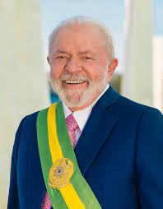
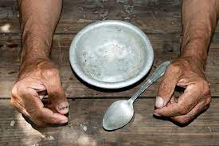
Values: democracy
government systems: president and parliament
Democracy and elections: Venezuela, El Salvador
Social democracy

Slide 11
Values: Equality
Right to have access, under general conditions of equality, to the public service of his country (AC)
Minorities

Slide 12
Values: rule of law
Judiciary Branch – independent

Slide 13
Values: human rights
free from discrimination on the basis of sex, racial or ethnic origin, religion or belief, disability, age or sexual orientation, the right to the protection of your personal data, and the right to get access to justice.

