Slide 1

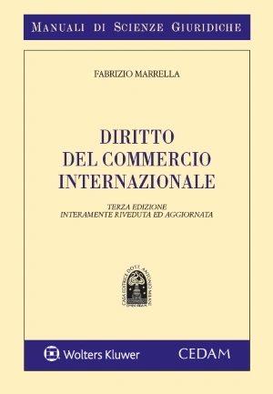
THE EU role in promoting Trade and Human Rights in the wider world
Prof. Avv. Fabrizio Marrella
Ordinario di Diritto internazionale
Università “Cà Foscari” Venezia

Slide 2
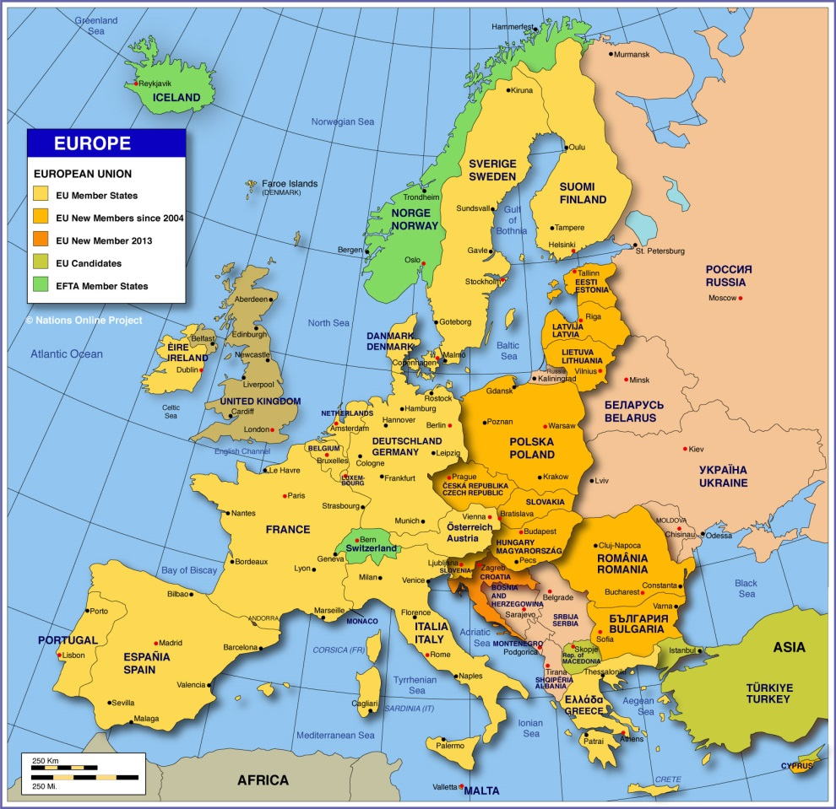
European Union - About
European Union is a political and economic union of 27 European countries (Excluding United Kingdom: Post Brexit)
A purely economic union European Economic Community (EEC), created in 1958 evolved into an organization spanning policy areas, from climate, environment and health to external relations and security, justice and migration named as European Union (EU) in 1993

Slide 3
THE EU HAS INTERNATIONAL LEGAL PERSONALITY
Article 47 of the Treaty on European Union explicitly recognises the legal personality of the European Union, making it an independent entity in its own right.
The conferral of legal personality on the European Union (EU) means that it has the ability to:
  conclude and negotiate international agreements and sign treaties in accordance with its external commitments;
  become a member of international organisations;
  join international conventions, such as the European Convention on Human Rights, as stipulated in Article 6(2) of the Treaty on European Union.

Slide 4
EU trade policy has largely been characterised by a commitment to more open and free trade, which is considered to lead to growth and jobs. Since the 1980s, the Commission has broadly pursued market access and trade liberalisation, both in terms of tariffs and NTBs, with the exception of trade defence, even if the specific aims are more nuanced in different areas of trade policy.
EU trade policy also aims to abide by the precautionary principle, as enshrined in the TFEU. This means that the EU prefers to play on the safe side where there are grounds for concern about dangerous effects on the environment, human, animal plant life, or health.
In 2015, the 'trade for all' strategy’ set out to make trade policy more effective, transparent and to pay special attention to values within the EU, by being responsive to the public's expectations on regulations and investment, and outside the EU, by promoting sustainable development, human rights and good governance. The strategy also highlighted the importance of the multilateral rules-based trading system, as embodied by the WTO.

Slide 5
What does the European Parliament do?
In 2009, the Lisbon Treaty gave Parliament full legislative power in the area of trade. Under the ordinary legislative procedure, Parliament and Council are on an equal footing for the adoption of trade-related acts proposed by the Commission.
The Lisbon Treaty also increased Parliament's formal powers on international trade agreements.
The Commission must inform the Parliament at all stages of negotiations. Most importantly, Parliament has a veto over trade agreements at the ratification stage when it must give its consent to the conclusion of an agreement with a yes/no vote. For mixed-competence agreements, Member State parliaments ratify in accordance with their own national procedures.
In practice, the European Parliament exercises a monitoring function that goes beyond the consent procedure. It can choose to adopt resolutions on the opening of negotiations and, over the course of negotiations, hold public hearings or workshops, and carry out relevant studies

Slide 6
What does the European Commission do?
The European Commission has a central role in EU trade policy on account of the exclusive EU competence. It proposes EU trade legislation and also prepares and negotiates EU trade agreements with third countries.
The Commission also publishes trade policy strategies, and implements EU trade policy. This can involve updating EU trade legislation through delegated and implementing acts.

Slide 7
What does the Council do?
With regard to trade agreements, Council authorises the opening of negotiations and decides on the conclusion of the agreement following the vote in Parliament. Council follows the negotiations closely. More specifically, the Trade Policy Committee (TPC) assists and advises the Commission in negotiations with third countries and in WTO-related work. The TPC meets monthly in its fullmember configuration and the TPC deputies meet weekly. The TPC has also other configurations, namely on services and investment, steel, textiles and other industrial sectors and mutual recognition agreements.
Both trade agreements and trade legislation are adopted in the Council on the basis of qualifiedmajority voting, which means that the agreement needs to be supported by 55 % of Member States, representing 65 % of the population. However, in practice, Council adopts decisions by common agreement in areas of shared competence

Slide 8
How does the EU support HUMAN RIGHTS through its FTAs?
In EU FTAs, sustainable development is understood broadly to have three main facets: economic
development, social development and environmental protection. Sustainability is addressed notably in trade and sustainable development (TSD) chapters, but also in many other parts of EU FTAs.
Pioneering obligations to abstain from lowering environmental, labour or social standards were introduced in an agreement between the EU and Caribbean countries (EU-Cariforum Economic Partnership Agreement 2008).
The Lisbon Treaty made the pursuit of sustainable economic, social, and environmental development a specific EU policy goal from 2009 onwards.

Slide 9
ART. 3 OF THE TFEU
The Union shall have exclusive competence in the following areas:
(a) customs union;
(b) the establishing of the competition rules necessary for the functioning of the internal market;
(c) monetary policy for the Member States whose currency is the euro;
(d) the conservation of marine biological resources under the common fisheries policy;
(e) common commercial policy.
2. The Union shall also have exclusive competence for the conclusion of an international agreement when its conclusion is provided for in a legislative act of the Union or is necessary to enable the Union to exercise its internal competence, or in so far as its conclusion may affect common rules or alter their scope

Slide 10
HOW TO CONCLUDE AN EU INTERNATIONAL AGREEMENT
The procedures for concluding international agreements are mainly set out in Article 218 of the Treaty on the Functioning of the European Union (TFEU). In the case of trade agreements, rules are also to be found in the specific provisions of Article 207 (TFEU) dealing with common commercial policy and any other article mentioned as a legal basis in the Council decisions to sign and to conclude a given trade agreement.

Slide 11
The European Parliament's role in negotiations
While the European Parliament has no formal role in starting and conducting trade negotiations, the TFEU imposes a duty of information: the European Parliament must be informed immediately and fully at all stages of the procedures. Moreover, the fact that the European Parliament has to give its consent at the end of the negotiations, has made it necessary to discuss some EU positions in the negotiations with the European Parliament first, in order for the Commission to verify the existence of political support. The Commission therefore reports regularly to both the European Parliament and the TPC. While it has no legal obligation to do so, Parliament will often signal its political position by issuing a resolution.

Slide 12
HOW FAR CAN THE CCP GO?
The common commercial policy (CCP), which defines EU trade policy, has always been an exclusive competence of the EU, however the content of the CCP has evolved over time. While services and intellectual property rights were originally considered shared competences, the Lisbon Treaty includes all services and commercial aspects of intellectual property rights within the CCP's scope (Article 207(1) TFEU). Article 207(1) TFEU also introduces foreign direct investment to the list of CCP competences. This evolution in the scope of CCP has led the Commission to consider whether it can conclude that some trade agreements focusing on purely commercial matters (including investment provisions) fall under exclusive EU competence. The argument of the Commission is contested by most Member States who consider that those agreements must be concluded as mixed. The main controversy between the Council and the Commission concerns whether investment now falls under exclusive EU competence

Slide 13
Once the Council has adopted the decision to sign the treaty, a date for its signature can be chosen. In practice, for mixed agreements, the EU and the Member States sign the treaty simultaneously. Signature signals the intention to conclude, it does not conclude the agreement as such.
The possibility for an international treaty to apply provisionally under EU law is set out
under Article 218(5) TFEU, which provides for the Council decision on provisional
application to be taken simultaneously with the Council decision to sign the treaty

Slide 14
PROVISIONAL APPLICATION OF MIXED AGREEMENTS
In the case of MIXED AGREEMENTS, the treaty enters into force only when the THIRD COUNTRY, the EU and all ITS Member States have exchanged ratification instruments.
The provisional application of mixed agreements negotiated by the EU takes place, however, before the completion of ratification procedures at the Member State level.
This makes sense as the entire rationale of provisional application is to allow for application while waiting for the completion of the ratification procedure. However provisional application under Article 218(5) TFEU can only be granted for provisions relating to EU competence and cannot include Member State competences unless all the Member States have agreed to it separately. Decisions on the provisional application of a mixed agreement in its entirety usually include a statement clarifying that Member States have given their agreement with respect to their competences.

Slide 15
European Union – Goals & Values
EU goal is:
To promote peace
Establish a unified economic and monetary system
Promote inclusion and combat discrimination
Break down barriers to trade and borders
Encourage technological and scientific developments
Champion environmental protection,
Promote goals like a competitive global market and social progress
The core values of EU are:
Human dignity
Freedom
Democracy
Equality
Rule of law
Human rights

Slide 16
AND WHAT ABOUT THE UNGPS ON BUSINESS AND HR?
State’s international human rights responsibilities
Extend to actions by non-state actors, including corporations
Extend to actions extra-territorially, including where corporations under direction of state
Include obligation to regulate all activity (including commercial) within its jurisdiction so as to protect human rights
Business international human rights responsibilities
No direct international responsibilities
Some responsibilities enforced by national courts
John Ruggie (UN Special Rapporteur) report: responsibility to respect
Business does acknowledge that they have corporate social responsibilities to respect human rights
Global Compact, self-regulation, voluntary codes, Corporate Social Responsibility policies

Slide 17
EU Trade and Investment Policy AS EU PILLAR ONE OF THE UNGPs
Three strands
CCP is an EXCLUSIVE COMPETENCE OF THE EU ex art.207 TFUE.
Dimensions of trade and Investment policy
Multilateral
Bilateral
Unilateral

Slide 18
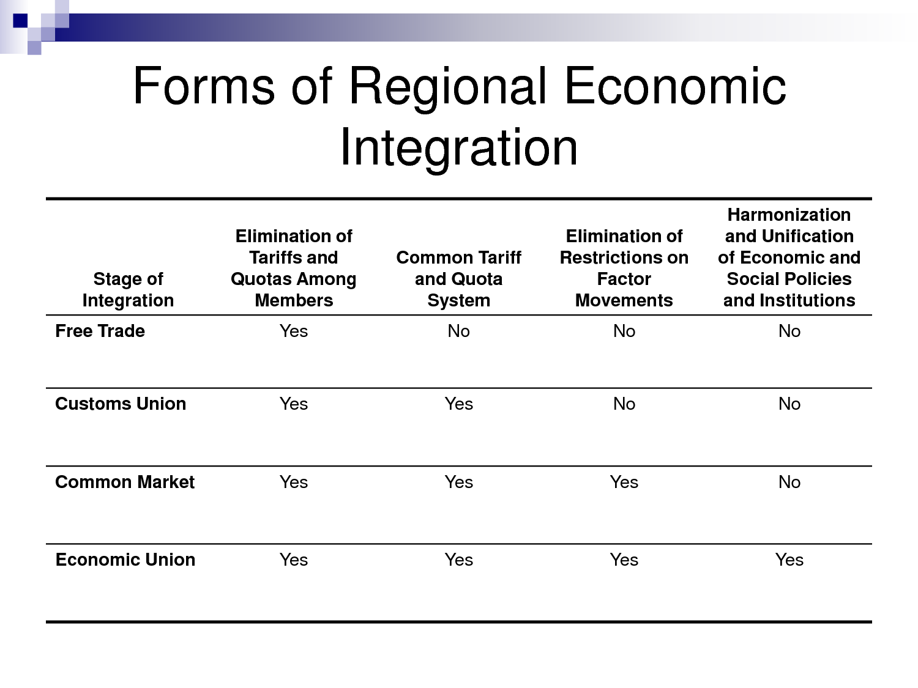

Slide 19

Common commercial policy: general view
A Commercial Policy (also referred to as a trade policy or international trade policy) is a governmental policy governing trade with third countries. This covers tariffs, trade subsidies, import quotas, Voluntary Export Restraints, restrictions on the establishment of foreign-owned businesses, regulation of trade in services and other barriers to international trade.

Slide 20
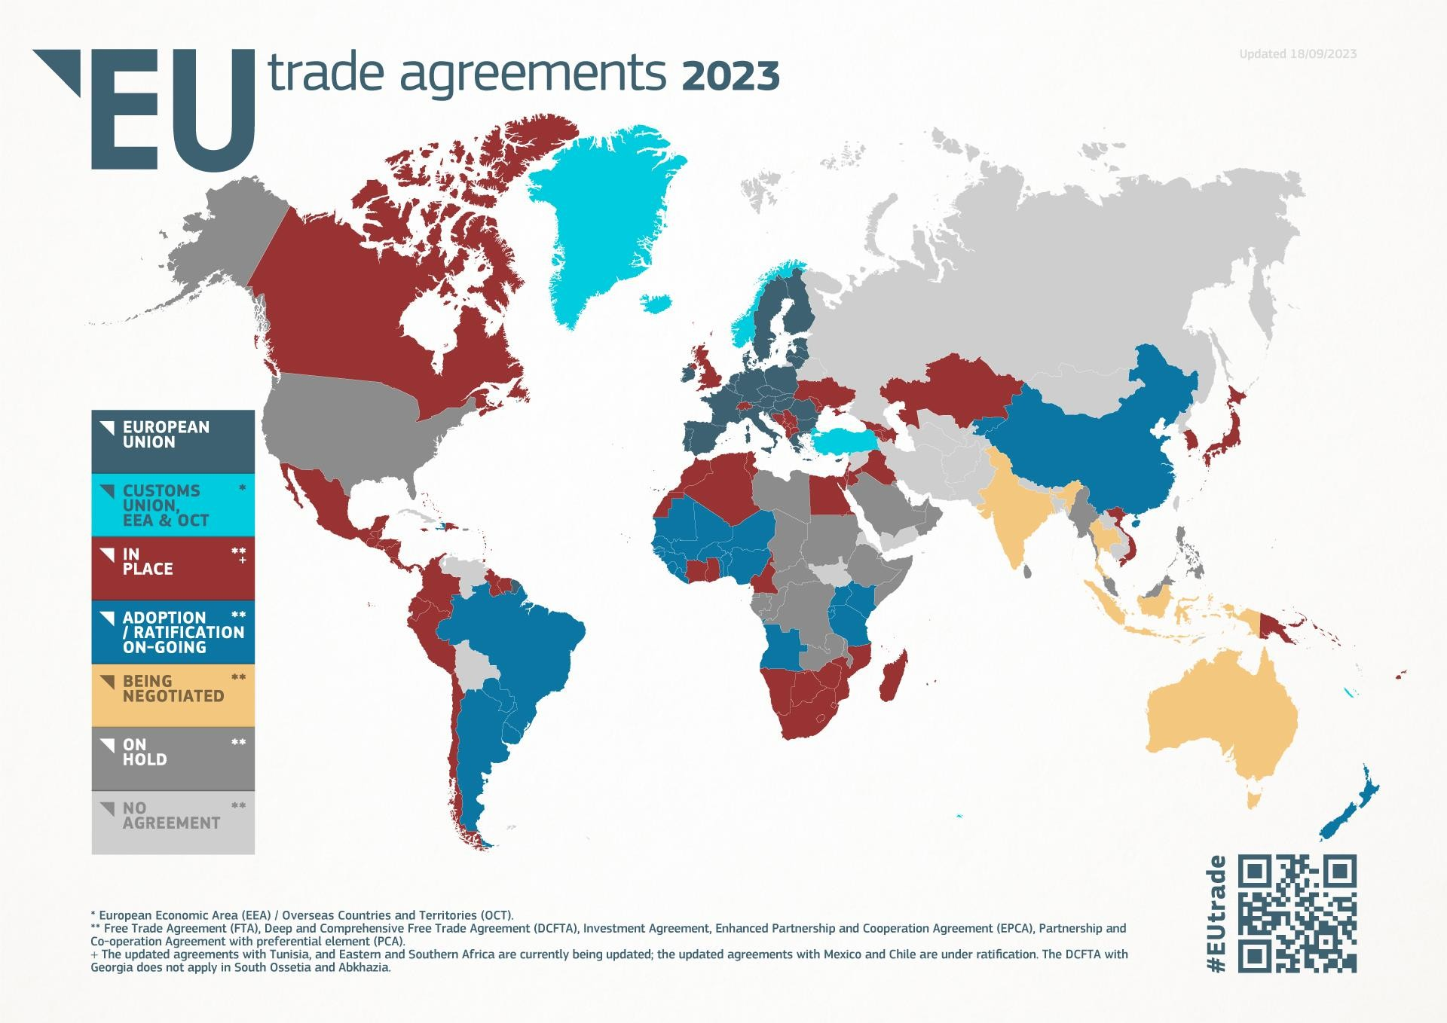

Slide 21
Unilateral dimension
Generalised Scheme of Preferences (GSP)
  Standard GSP
  Everything But Arms (EBA)
  GSP+
Trade Defence Instruments
  Anti-dumping
  Anti-subsidy
  Safeguard measures

Slide 22













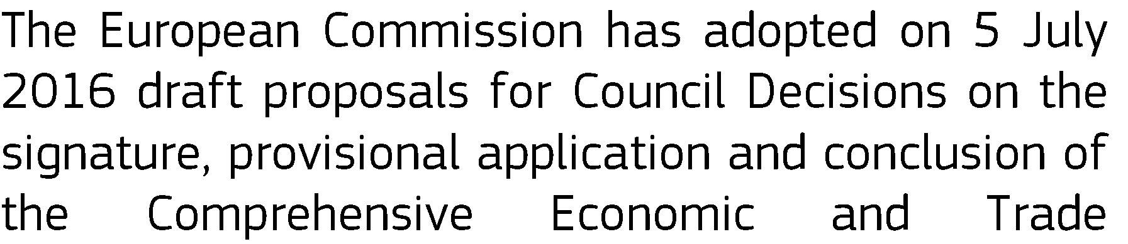




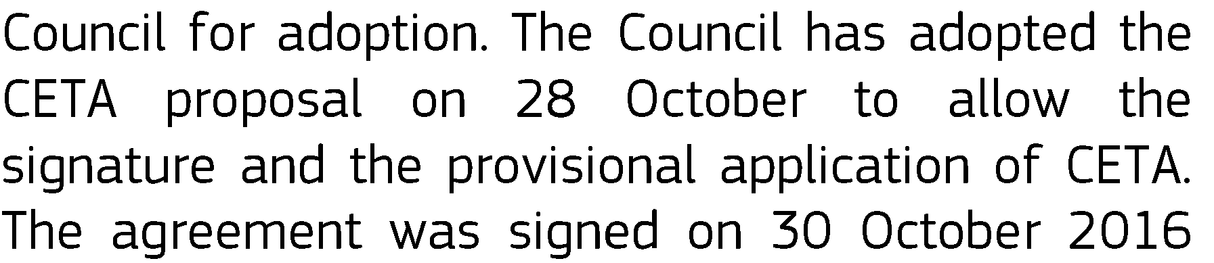




Notes:
https://policy.trade.ec.europa.eu/eu-trade-relationships-country-and-region/negotiations-and-agreements_en

Slide 23






















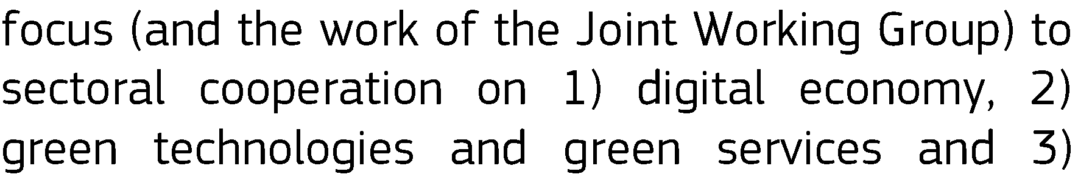






















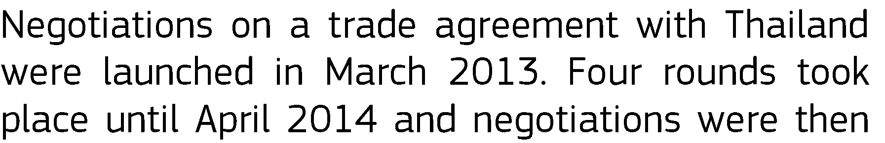







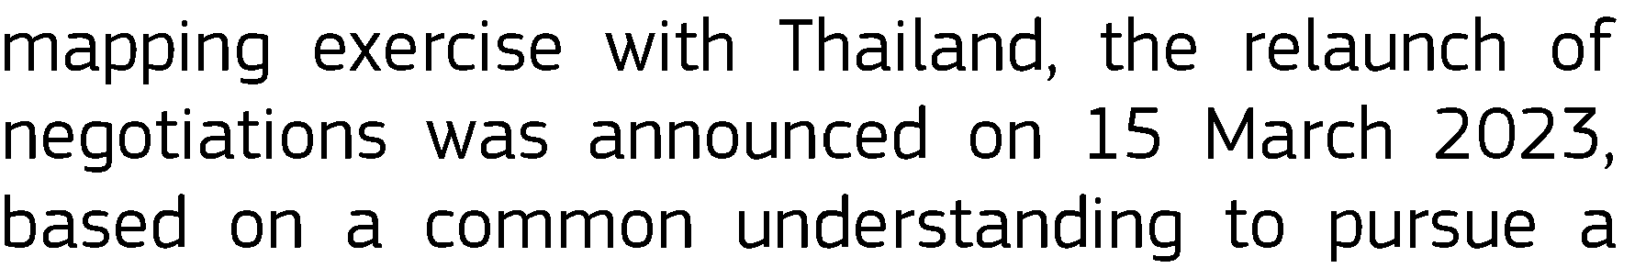

Slide 24
EU Trade and Investment Policy
How we negotiate
Civil Society and Public Consultations
The Commission negotiates
On behalf of the 27 Member States
Regular reporting to the Council and the European Parliament
The Council co-decides
Directives for negotiations
Follows the negotiation process
Council approve the results of the negotiation (generally by qualified majority)
The Parliament co-decides
EP co-decides with the Council on trade legislations (except negotiating directives)
EP gives consent on
agreements

Slide 25
REGULATION TECHNIQUES
HARD LAW V. SOFT LAW
HARD POWER /MUSCULAR DIPLOMACY V. SOFT POWER (lead by example, education, economic incentives, etc.)

Slide 26

The exemple of EU & Pakistan
European Union is a partner of Pakistan since 1962
The EU is represented in Pakistan by the Islamabad-based Delegation of the European Union
The European Union Delegation was established in Pakistan in 1985 with the objective of fostering closer and stronger ties

Slide 27
EU & Pakistan - Relation
The EU’s bilateral relations with Pakistan are guided by the EU-Pakistan Strategic Engagement Plan, signed in June 2019, and by the 2004 Cooperation Agreement on Partnership and Development

Slide 28
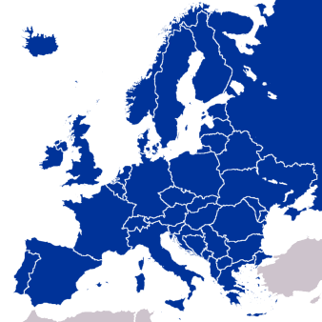


Economic Connection
The EU is Pakistan’s 2nd largest trading partner
The EU is Pakistan's main export destination
The EU accounts for 16% of Pakistan's total trade
The total EU’s FDI stock in Pakistan is 7.4%
35%
7.4%

Slide 29

Rule of Law and Human Rights
The EU looks to work with all stakeholders in Pakistan in order to:
  strengthen the rule of law
  promote and protect human rights, including freedom of expression and media, freedom of religion and women’s rights
The EU’s preferential trade regime with Pakistan, GSP+, directly promotes human rights and labour rights as well as good governance standards and environmental protection
At the multilateral level, the EU and Pakistan constructively cooperate in the Human Rights Council in Geneva

Slide 30

Observation Missions
The 2018 EU Election Observation Mission was the fourth consecutive such mission from the EU to Pakistan
The Missions recommendations contributes to the overall improvement of the legal framework for elections and the consolidation of democracy in Pakistan

Slide 31



People-to-People Contacts
7,700 new visas were issued for students in 2017
+ 20% of visas more for students every year
Pakistan has for years been among the top ten partner countries benefitting from Erasmus Mundus exchanges

Slide 32






The EU’s engagement in Pakistan is helping
45 million of Pakistan’s poorest out of poverty
> than 4.5 million children and pregnant and lactating women and children to receive nutrition support for the period 2019-2021
young people to have access to 1,200 enhanced, standardised training courses
37 police stations now have specific contact points for women
rural populations to benefit from specific support programmes (€180 million provided via national non-profit organisations)
225,000 people in Pakistan to benefit from technical and vocational educational training (€132 million provided)

Slide 33
MAIN LEGAL CHARACTERS OF THE POLICY
INCLUSION IN ALL CCP AGREEMENTS?: EU treaty relations with all third countries should be governed by an effective human rights clause consisting of an ‘essential elements’ clause, a ‘positive obligations’ clause, and a ‘non-fulfilment’ clause providing for the adoption of appropriate measures in the event of a failure to comply with these obligations.
However, the trade agreements with Canada and Japan are not effectively covered by human rights clauses. “HR at different speed??”
WORDING : specific human rights in “essential elements clauses”. HR agreements already in force v. not in force
MONITORING AND ENFORCEMENT. All agreements containing human rights clauses should provide for permanent Human Rights Committees with a mandate to monitor the implementation of the parties’ obligations, as set out in the respective essential elements clause. Wich powers?? Or is it just POLITICAL DIALOGUE?
HUMAN RIGHTS CLAUSES AND GENERAL EXCEPTIONS TO AGREEMENTS. The design of human rights clauses is based on an enforcement model according to which one party is entitled to adopt ‘appropriate measures’, which would otherwise not be permitted under the agreement, when the other party violates human rights norms in the essential elements clause.

Slide 34
– Framework agreements
Framework agreements Part I | Vietnam FA (2012)¹⁵² | Canada SPA (2016) | NZ PA (2016) | Australia FA (2017) | Singapore PCA (2018)
Essential elements | Article 1(1) | Article 2(1) | Article 2(1) | Article 2(2) | Article 1(1)
 | The Parties confirm | Respect for | Respect for | … Respect for | Respect for
 | their commitment to | democratic principles, | democratic principles | democratic principles | democratic principles,
 | … the respect for | human rights and | and human rights and | and human rights and | the rule of law and
 | democratic principles | fundamental | fundamental | fundamental | fundamental human
 | and human rights, as | freedoms, as laid | freedoms as laid down | freedoms as laid down | rights, as laid down in
 | laid down in the UN | down in the Universal | in the Universal | in the Universal | the Universal
 | General Assembly | Declaration of Human | Declaration of Human | Declaration of Human | Declaration of Human
 | Universal Declaration | Rights and existing | Rights and other | Rights, as given | Rights and other
 | of Human Rights and | international human | relevant international | expression in the | applicable
 | other relevant | rights treaties and | human rights | International | international human
 | international human | other legally binding | instruments, and for | Covenant on Civil and | rights instruments to
 | rights instruments to | instruments to which | the principle of the | Political Rights and the | which the Parties are
 | which the Parties are | the Union or the | rule of law, underpins | International | Contracting Parties,
 | Contracting Parties, | Member States and | the domestic and | Covenant on | underpins the internal
 | which underpin the | Canada are party, | international policies | Economic, Social and | and international
 | internal and | underpins the Parties' | of the Parties and | Cultural Rights, and | policies of the Parties
 | international policies | respective national | constitutes an | other international | and constitutes an
 | of both Parties and | and international | essential element of | human rights | essential element of
 | which constitute an | policies and | this Agreement. | instruments which the | this Agreement.
 | essential element of | constitutes an |  | Parties have ratified or
 | this Agreement. | essential element of |  | acceded to, and for
 |  | this Agreement. |  | the principle of the
 |  |  |  | rule of law, underpins
 |  |  |  | the domestic and
 |  |  |  | international policies
 |  |  |  | of the Parties and
 |  |  |  | constitutes an
 |  |  |  | essential element of
 |  |  |  | this Agreement.
.

Slide 35
Assessment of the implementation of the human rights clause
in international and sectoral agreements
Framework agreements Part I | Vietnam FA (2012)¹⁵² | Canada SPA (2016) | NZ PA (2016) | Australia FA (2017) | Singapore PCA (2018)
Positive obligation | Article 57(1) | Article 28(1) | Article 54(1) | Article 57(1) | None
 | The Parties shall take any general or specific measures required to fulfil their obligations under this Agreement and shall ensure that they comply with the objectives and purposes laid down in this Agreement. | [T]he Parties shall take the general or specific measures required to fulfil their obligations under this Agreement. | The Parties shall take any general or specific measures required to fulfil their obligations under this Agreement. | [T]he Parties shall take the general or specific measures required to fulfil their obligations under this Agreement.
Appropriate measures | Article 57 | Article 28 | Article 54 | Article 57 | Article 44
Trigger for appropriate measures (standard of human rights violations) | 2. If either Party considers that the other Party has failed to fulfil any of its obligations under this Agreement it may take appropriate measures. | 3. [T]he Parties consider that a particularly serious and substantial violation of the obligations described in [Article 2(1) may be addressed as a case of special urgency. The Parties consider that, for a situation to constitute a ‘particularly serious and substantial violation’ of Article 2(1), its gravity and nature would have to be of an exceptional sort such as a coup d'État or grave crimes that threaten the peace, security and | 3. [I]f either Party considers that the other Party has committed a particularly serious and substantial violation of any of the obligations described in Articles 2(1) … as essential elements, which threatens international peace and security so as to require an immediate reaction …. | 57(4). [In case of special urgency] … either Party may decide to take appropriate measures …. 57(7). … the term 'case of special urgency' means a particularly serious and substantial violation of the obligations described in [Article 2(2)] … of this Agreement by one of the Parties leading to a situation which requires an immediate reaction by the other. The Parties consider that a particularly serious and substantial | 1. If either Party considers that the other Party has failed to fulfil any of its obligations under this Agreement it may take appropriate measures …

Slide 36
Policy Department, Directorate-General for External Policies
Framework agreements Part I | Vietnam FA (2012)¹⁵² | Canada SPA (2016) | NZ PA (2016) | Australia FA (2017) | Singapore PCA (2018)
Suspension as an appropriate measure |  | 6. (a) In a case of special urgency … either Party may decide to suspend the provisions of this Agreement … | 7. ‘[Appropriate] measures’ means the suspension in part, suspension in full or termination of this Agreement | 57(4). … either Party may decide to take appropriate measures with regard to this Agreement, including the suspension of its provisions or its termination …. | 4. … the term ‘appropriate measures’ in this Article means the suspension of, or the non-performance for the time being of obligations under this Agreement …
Proportionality | 4. … the term ‘appropriate measures’ as referred to in Article 57(2) means measures taken in accordance with international law which are proportionate to the failure to implement obligations under this Agreement. In the selection of these measures, priority must be given to those which least disturb the functioning of this Agreement. |  | In the selection of appropriate measures, priority must be given to those which least disturb the relations between the Parties. These measures, which are subject to Article 52(2), shall be proportionate to the violation of obligations under this Agreement, and shall be in accordance with international law. | 57(5). … any such measures must be proportionate and must be consistent … with the general principles of international law. | 4. Appropriate measures shall be taken in accordance with international law and shall be proportionate to the failure to implement obligations under this Agreement.
Prior notification and/or consultations | 4. … [Appropriate] measures shall be notified immediately | 5. In … a case of special urgency …, either Party may seize | 3. … it shall immediately notify the other Party of this fact | 57(3). In a case of special urgency, either Party shall | 2. In cases of special urgency, the intended appropriate measure

Slide 37
Policy Department, Directorate-General for External Policies
Framework agreements Part I | Vietnam FA (2012)¹⁵² | Canada SPA (2016) | NZ PA (2016) | Australia FA (2017) | Singapore PCA (2018)
EU procedure |  | 6(a). In the Union, the decision to suspend [this Agreement in case of special urgency] would entail unanimity | 6. In the Union, the decision to suspend [this Agreement in case of special urgency] would entail unanimity | 57(5). In the Union, the decision to suspend [this Agreement in case of special urgency] would entail unanimity
Review |  | 6(b) The Parties shall keep under constant review the development of the situation which prompted that decision and which could serve as grounds for other | 8. The Parties shall keep under constant review the development of the situation which prompted action under this Article. The Party taking the appropriate measures | 57(6). If any measure is taken in accordance with paragraph 4 [special urgency] it shall be revoked as soon as the reason for taking it has been removed. The Party invoking paragraph 4

Slide 38
Assessment of the implementation of the human rights clause
in international and sectoral agreements
Framework agreements Part II | Japan SPA (2018) | ACP-EU PA (2021) | Thailand FA (2022) | Malaysia PCA (2022)
Essential elements | Article 2(1) | Article 9(7) | Article 1(1) | Article 1(1)
 | The Parties shall continue to uphold the shared values and principles of democracy, the rule of law, human rights and fundamental freedoms which underpin the domestic and international policies of the Parties. In this regard, the Parties reaffirm the respect for the Universal Declaration of Human Rights and the relevant international human rights treaties to which they are parties. | [R]espect for human rights, democratic principles and the rule of law shall underpin their domestic and international policies and constitute an essential element of this Agreement. | Respect for democratic principles and human rights, as laid down in the Universal Declaration of Human Rights and in other relevant international human rights instruments applicable to the Parties, and for the principle of the rule of law, underpins the internal and international policies of the Parties, and constitutes an essential element of this Agreement. | Respect for democratic principles and human rights, as laid down in the Universal Declaration of Human Rights and in other relevant international human rights instruments applicable to the Parties, and for the principle of the rule of law, underpins the internal and international policies of the Parties, and constitutes an essential element of this Agreement.
Positive obligation | Article 43(1) | Article 101(1) | Article 55(1)
 | The Parties shall take any general or specific actions required to fulfil their obligations under this Agreement, based on the principles of mutual respect, equal partnership and respect for international law. | The Parties shall take any general or specific measures required to fulfil their obligations under this Agreement … | The Parties shall take any general or specific measures required to fulfil their obligations under this Agreement. | None

Slide 39
Policy Department, Directorate-General for External Policies
Framework agreements Part II | Japan SPA (2018) | ACP-EU PA (2021) | Thailand FA (2022) | Malaysia PCA (2022)
Appropriate measures | Article 43(4) | Article 101 | Article 55 | Article 53
Trigger for appropriate measures (standard of human rights violations) | [A] particularly serious and substantial violation of the obligations described in paragraph 1 of Article 2 ... [which] constitutes an essential element of the basis of the cooperation under this Agreement, with its gravity and nature being of an exceptional sort that threatens peace and security and has international repercussion, may be addressed as a case of special urgency. | … if either Party considers that the other Party is in violation of any of the essential elements as set out in Article 9 ..., except in case of special urgency, … the notifying Party may take appropriate measures. If either Party considers that a violation of any of the essential elements constitutes a case of special urgency, it may take appropriate measures with immediate effect, without prior consultations. Cases of special urgency shall refer to exceptional cases of particularly serious and flagrant violation of one of the essential elements referred to in [Article 9] | If either Party considers that the other Party has failed to fulfil any of its obligations under this Agreement, it may take appropriate measures in accordance with international law. [for ordinary violations] … [a] Party may take appropriate measures. 5. If either Party has serious grounds to consider that the other Party has failed to fulfil in a substantial manner any of the obligations that are described as essential elements in [Article 1(1)] … [it] may apply appropriate measures. | 3. If either Party considers that the other Party has failed to fulfil any of the obligations that are described as essential elements in [Article 1(1)] … the notifying Party may take the appropriate measures.

Slide 40
Assessment of the implementation of the human rights clause
in international and sectoral agreements
Framework agreements Part II | Japan SPA (2018) | ACP-EU PA (2021) | Thailand FA (2022) | Malaysia PCA (2022)
Suspension as an appropriate measure | 6. In a case of special urgency [a party] may decide to suspend the provisions of this Agreement … | 8. Appropriate measures may include the suspension, in part or in full, of this Agreement. | 6. For the purposes of paragraph 4, ‘appropriate measures’ may include the suspension of this Agreement, in whole or in part. For the purposes of paragraph 5, ‘appropriate measures’ may include the suspension of this Agreement, in whole or in part, or of any specific agreement referred to in Article 53(1). | 3. For the purpose of this paragraph ‘appropriate measures’ means any measure recommended by the Joint Committee or the suspension, in part or in full, of this Agreement or of any specific agreement within the meaning of Article 52(2).
Proportionality | 6. In a case of special urgency [a party] may decide to suspend the provisions of this Agreement in accordance with international law | 8. ‘Appropriate measures’ referred to in paragraphs 6 and 7 shall be taken in full respect of international law and shall be proportionate to the failure to implement obligations under this Agreement. Priority shall be given to those which least disturb the functioning of this Agreement… | 6. In the selection of the appropriate measures, priority must be given to those which least disturb the functioning of this Agreement or, as the case may be, of any other specific agreement referred to in Article 53(1). Such measures shall be temporary in nature and proportionate to the violation with a view to encouraging the eventual fulfilment of the obligations. | 4. Any appropriate measure taken shall be proportionate to the failure to implement obligations under this Agreement and shall not affect the continuation of other obligations under this Agreement not affected by the situation. In the selection of the appropriate measure, priority must be given to those which least disturb the functioning of this Agreement or of any specific agreement within the meaning of Article 52(2).

Slide 41
Policy Department, Directorate-General for External Policies
Notification and/or consultations | In the unlikely and unexpected event that a case of special urgency as referred to in paragraph 4 occurs within the territory of either Party, the Joint Committee shall hold an urgent consultation within 15 days upon the request of the other Party. In case the Joint Committee is unable to reach a mutually acceptable solution, it shall convene urgently at ministerial level on that matter. … In a case of special urgency where no mutually acceptable solution has been found at ministerial level, the Party which made the request referred to in paragraph 5 may decide to suspend the provisions of this Agreement in accordance with international law. The Party shall immediately notify the other Party, in writing, of its decision and shall apply that decision for the minimum period of time necessary to resolve the issue in a manner acceptable to the Parties. | 6. [I]f either Party considers that the other Party is in violation of any of the essential elements as set out in Article 9 and Article 18, except in case of special urgency … it shall notify the other Party, presenting all relevant information required for a thorough examination of the situation, with a view to seeking a mutually acceptable solution within 60 days of the date of notification. Should this be deemed not sufficient, the Parties shall hold structured and systematic consultations. While preserving the bilateral character of the consultations, a special joint committee shall be involved upon agreement of the Parties concerned during the structured and systematic consultations phase. The Special Joint Committee, consisting of an equal number of representatives of the [EU Party] and OACPS Members abiding by the principles of genuine partnership and mutual accountability, shall provide advice on the fulfilment of obligations and assist as appropriate so that | Before taking appropriate measures referred to in paragraph 3, except in the cases referred to in paragraph 5, such Party shall present to the Joint Committee all the relevant information required for a thorough examination of the situation with a view to seeking a solution acceptable to the Parties. The Parties shall hold consultations under the auspices of the Joint Committee. Where the Joint Committee is unable to reach a mutually acceptable solution, such Party may take appropriate measures. If either Party has serious grounds to consider that the other Party has failed to fulfil in a substantial manner any of the obligations that are described as essential elements in [Article 1(1)], it shall immediately notify the other Party of such non- fulfilment. At the request of either Party, the Joint Committee, or another body designated by mutual agreement of the Parties, shall hold immediate consultations within a period of up to 30 days for a thorough examination of | 3. … it shall immediately notify the other Party of this fact and the appropriate measures it intends to take. The notifying Party shall advise the Joint Committee of the need to hold urgent consultations on the matter. Where the Joint Committee is unable to reach a mutually acceptable solution within 15 days from the commencement of consultations, and no later than 30 days from the date of the notification, the notifying Party may take the appropriate measures.

Slide 42

THANK YOU FOR YOUR ATTENTION !
Prof. Avv. Fabrizio Marrella
University of Venice «Cà Foscari» / Global Campus of Human Rights
Contacts: marrella@unive.it
Linkedin: Fabrizio Marrella

