Slide 1
Upholding and promoting the sustainable development of the Earth through international agreements
Winter School 2024
Reinforcing EU responsible global leadership Promoting EU values for a rules-based multilateral world
Prof. Tarin Frota Mont`Alverne
Universidade Federal do Ceará - Brazil

Slide 2
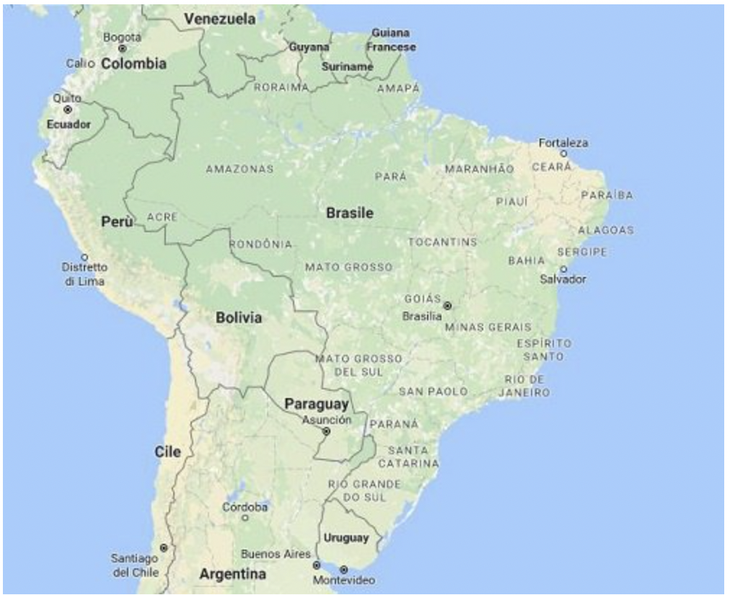
Where?
www.ufc.br

Slide 3
Interest Area:
Climate change
Energy
Ocean
Biodiversity
Circular economy
Just transition
@gedaiufc and @suadyouthcop

Slide 4
Summary:
Introduction
Emergence of international environmental protection
Multilateral Environmental Conferences: an era of agreements and environmental initiatives
Fragmentation of the international environmental agenda: the need for integration of the SDGs based on equality
Summit of the Future: towards multilateral solutions for effective promotion of sustainable development?

Slide 5
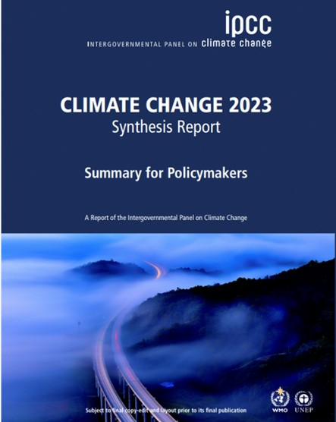
Let's start with a quiz

Slide 6
Key Question
Is it possible to effectively protect the environment without the involvement of international law?

Slide 7
Introduction: Contextualization of the multilateral environmental agenda
The concept of environmental issues as "glocal" – combining global and local dimensions.
Environmental challenges transcend political borders, economic barriers, and ideological differences.
The interconnectedness of elements like the atmosphere, soil, water, and natural resources.

Slide 8
Introduction: Contextualization of the multilateral environmental agenda
The limitations of national governments in addressing global challenges, such as climate change, biodiversity loss, and pollution.
The essential role of cooperation between countries at both regional and global levels is crucial for effective sustainable development

Slide 9
Emergence of international environmental protection
In the perspective of French Professor A. KISS, the year 1968 signifies the commencement of what can be termed the 'ecological era’.

Slide 10
Emergence of international environmental protection
Key Developments in International Environmental Protection (1968):
Council of Europe Declarations on Air Pollution and Water Resources.
Organization of African Unity approves the African Convention on Conservation.
Proposal for the Stockholm Conference on Human Environment by Sweden during the UN Economic and Social Council Spring Session.

Slide 11
An Era of Environmental Agreements and Initiatives
Global Compact for Environmental Protection: Adopting Bilateral, Regional and Multilateral Commitments
The integration of sustainable development in significant international norms: WTO, FAO, UNESCO…

Slide 12
An Era of Environmental Agreements and Initiatives
Example:
The Marrakesh Agreement, which established the World Trade Organization in 1994, states in its Preamble that 'if free trade is an instrument of growth, it must be used in accordance with the requirements of sustainable development.

Slide 13
But…
Criticism: Examining the Timing of New International Environmental Treaties.
Historical Precedents: The Torrey Canyon Oil Spill and Brussels Convention (1967-1969)
Nuclear Disaster Response: Chernobyl Accident and IAEA Instruments (1986)
Contemporary Challenges: Global Plastic Agreement Negotiations (Recent Example)

Slide 14
Let's watch this video
https://youtu.be/cEeKerZ7iU4?si=1HIrpAD8qJ2nVSKy
https://www.youtube.com/watch?v=Yomf5pBN8dY

Slide 15
Multilateral Environmental Conferences
Three pivotal International Conferences:

Slide 16
Multilateral Environmental Conferences
What common threads or significant advancements do you think emerged from these key gatherings, shaping the landscape of global environmental policies?

Slide 17
The first global political meeting on the environment, recognised as a milestone in international environmental law.
Importance of marking the beginning of the modern era of environmental awareness and action.
Geopolitical dynamics: dichotomy between the Global North and the Global South in the multilateral sustainable development agenda
Stockholm Conference

Slide 18
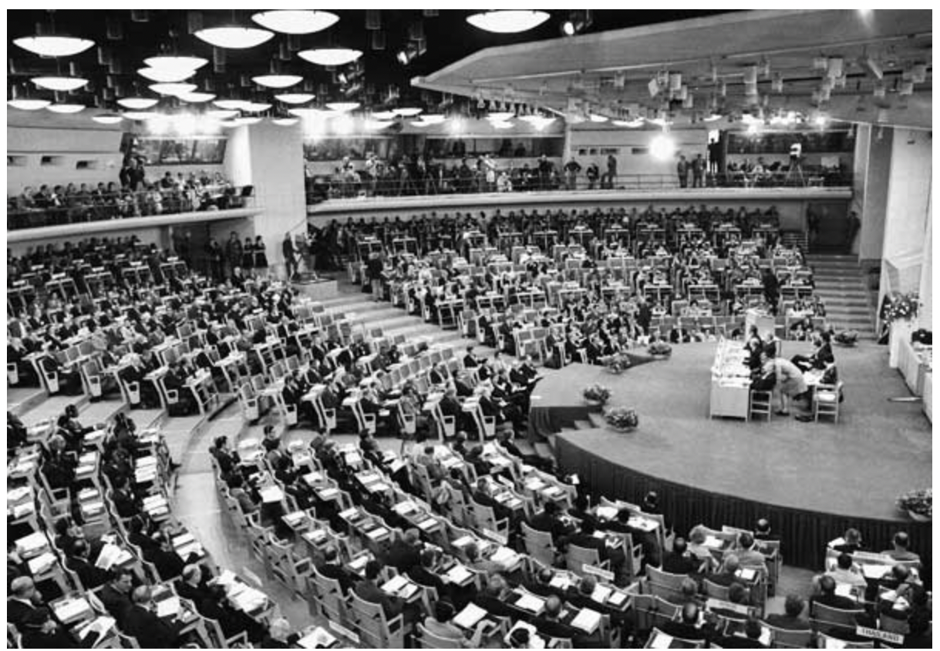
Stockholm Conference
Such oppositions were articulated by developing countries:
"Welcome to pollution, we are open to it. Brazil is a country that has no restrictions; we have several cities that would welcome your pollution with open arms because we want jobs and dollars for our development." (Brazil)
"If you want us to be clean, pay for our soap!" (African countries)

Slide 19
Such oppositions were articulated by developing countries:
Stockholm Conference
"Is not poverty and need the greatest polluters?”
Prime Minister Indira Gandhi

Slide 20
Essential Components of Reflection: Contemporary Illustrations and Historical Challenges
The European Union aims to become the world's first carbon-neutral continent, but the European Union's need for raw materials.
Challenges in monitoring the environmental and social impacts of mining in developing countries
The importance of ensuring a just energy transition in supplier countries."

Slide 21
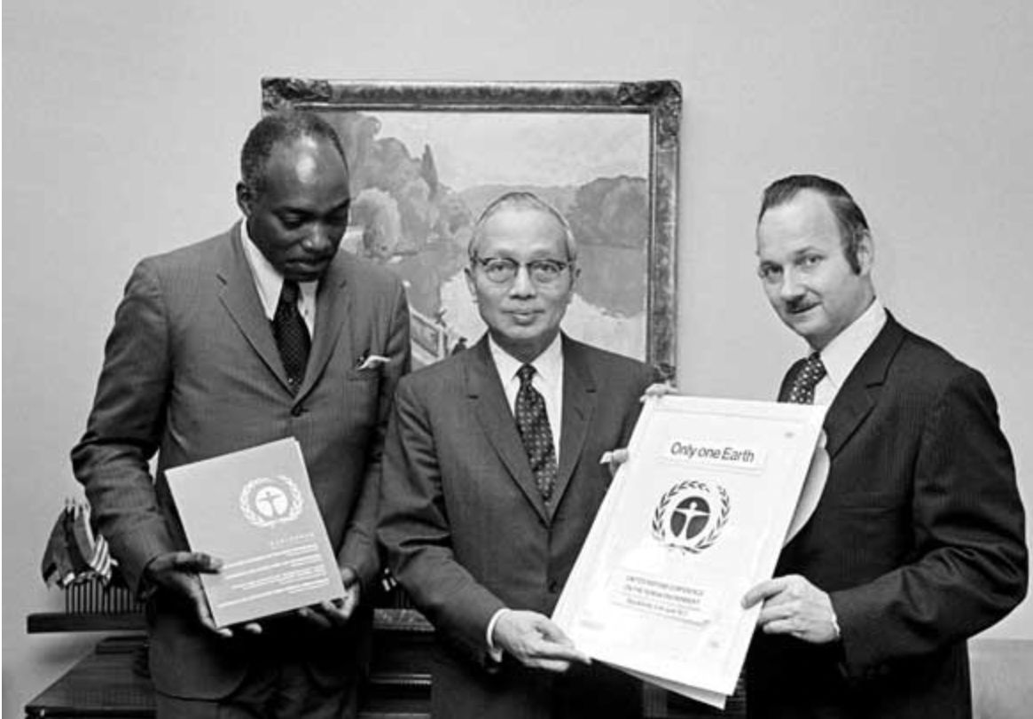
Successful Adoption of Three Key Documents:
1. United Nations Declaration on the Human Environment - Stockholm Declaration
Stockholm Conference

Slide 22
1. Stockholm Declaration:
Fundamental document in international environmental law.
26 principles: a cornerstone for international environmental law
Global Guidepost: Influence on Environmental Standards
Stockholm Conference

Slide 23
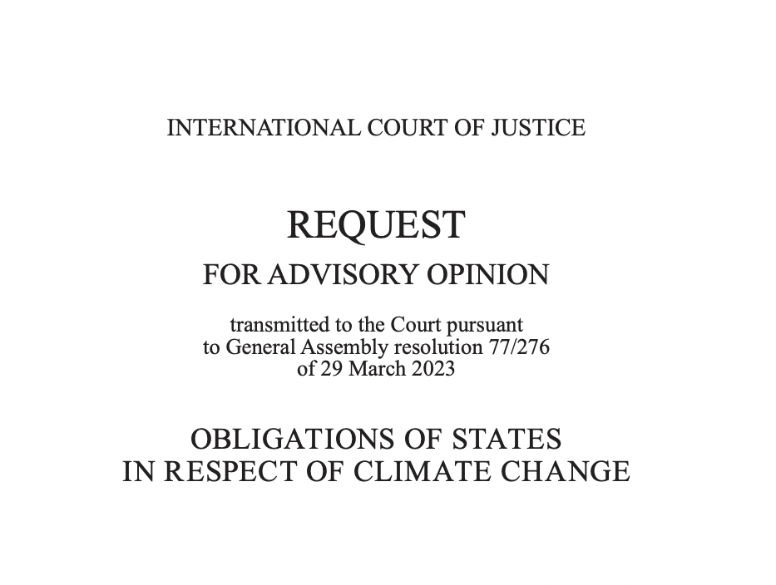
Essential Components of Reflection: Contemporary Illustrations
The Advisory Opinion's role in contributing to the advancement of sustainable development.
Key question: state obligations under international law for safeguarding the climate system and other environmental aspects from greenhouse gas emissions.
The integral connection with the Stockholm Declaration, showcasing its historical significance and its ongoing relevance in contemporary environmental discussions.

Slide 24
2. Plan of Action for the Human Environment :
109 recommendations
This document is not directly aligned with contemporary sustainable development goals, but its historical importance is significant
Stockholm Conference

Slide 25
3. Creation of the United Nations Environment Programme (UNEP)
Stockholm Conference
The leading global authority on the environment
193 Member States

Slide 26
Key Points:
Significant impact on the formulation of several important treaties that have established the basis of international environmental legislation.
It led to the creation of ministries, specialised bodies and the development of environmental law at national and international level.
Key role in global environmental governance.
Stockholm Conference

Slide 27
United Nations Conference on Environment and Development Rio 92
Pivotal moment in the evolution of international environmental discussions, constituting the second significant step in this trajectory.
Unprecedented results: Among the conferences ("new themes”) held during the 1990s, none produced as many results as Eco-92

Slide 28
United Nations Conference on Environment and Development Rio 92
Successful adoption of several important international agreements :
Rio Declaration on Environment and Development
Agenda 21
Declaration of Principles on Forests
Convention on Biological Diversity
United Nations Framework Convention on Climate Change (UNFCCC)
United Nations Convention to Combat Desertification (UNCCD)

Slide 29
United Nations Conference on Environment and Development Rio 92
Key Points:
Fundamental role in reshaping the international environmental discourse.
Establishment of fundamental principles and conventions that remain influential in global sustainable development efforts.

Slide 30
United Nations Conference on Sustainable Development Rio+20
Twenty years after Rio 92
Two central Themes: the green economy within the context of sustainable development and poverty eradication, and the institutional framework for sustainable development, including the possibility of creating an international organization for the environment.

Slide 31
United Nations Conference on Sustainable Development Rio+20
Only one document was adopted:
The lack of consensus among states to commit to binding agreements or new common principles during the conference.
Lack of evaluation
Inability to Update Agenda 21

Slide 32
United Nations Conference on Sustainable Development Rio+20
The creation of a World Environment Organisation: the focus of discussions at Rio+20
But…
The states created only the United Nations Environment Assembly (UNEA)

Slide 33
United Nations Conference on Sustainable Development Rio+20
The highest-level global decision-making body on the environment, representing all 193 UN Member States.
Shaping and guiding international efforts towards a sustainable and environmentally responsible future.
Providing comprehensive policy guidance and formulating policy responses to emerging environmental challenges.

Slide 34
United Nations Conference on Sustainable Development Rio+20
Key Insights
The Oceans in Global Sustainability Efforts: A Critical Shift Post-Rio+20
Highlighting the Embrace of Ocean Conservation: A positive takeaway from Rio+20 was the inclusion of ocean conservation and sustainable use in the document "The Future We Want.”
Addressing the Knowledge Gap: Despite covering 71% of the planet, our understanding of oceans remains limited to less than five per cent, highlighting the urgency of increased attention and protection efforts

Slide 35
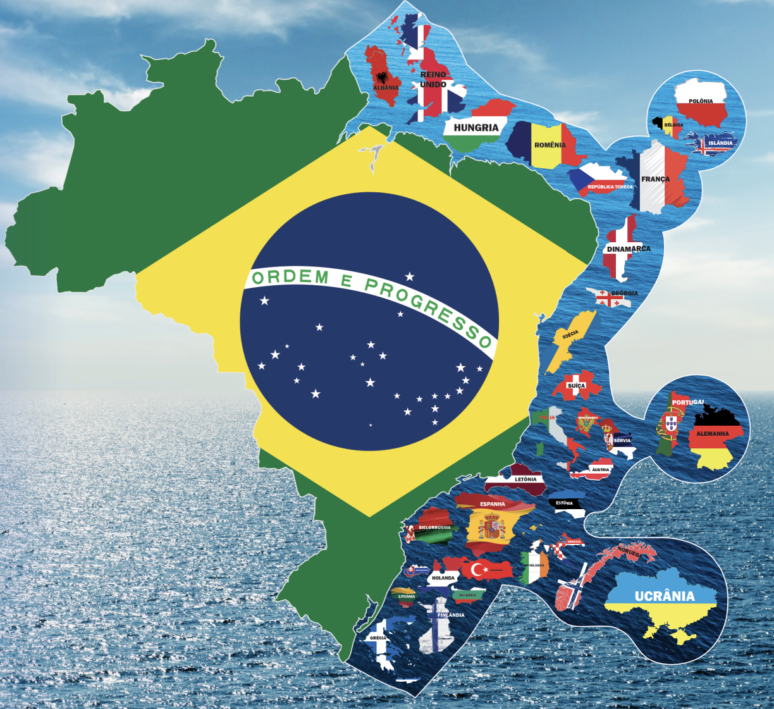
United Nations Conference on Sustainable Development Rio+20
Key Insights: Brazilian perspective

Slide 36
Agenda 2030 Sustainable Development Goal

Slide 37
Multilateral Environmental Conferences

Slide 38
Multilateral Environmental Conferences
Does the planet have another 50 years to reverse these crises?

Slide 39
Multilateral Environmental Conferences
What if Stockholm 1972 had not taken place?
If these international legal instruments had not been adopted?

Slide 40
Fragmentation of the International Environmental Agenda: The Need for Integrated SDG Approaches Based on Equality
Recent Milestones in Multilateral Sustainable Development:

Slide 41
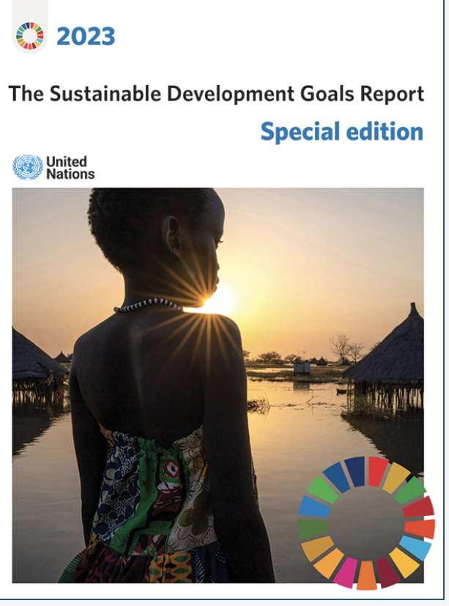
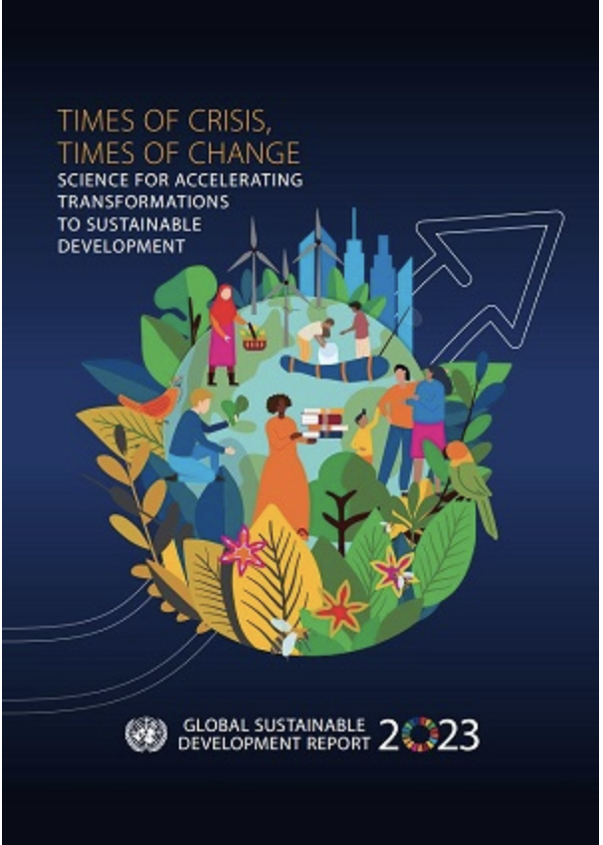
Fragmentation of the International Environmental Agenda: The Need for Integrated SDG Approaches Based on Equality
2023: The Midpoint Assessment of Agenda 2030

Slide 42
Let's watch this video
https://www.youtube.com/watch?v=zF361a019zA

Slide 43
Fragmentation of the International Environmental Agenda: The Need for Integrated SDG Approaches Based on Equality
Looking Ahead: High-Level Event in 2024

Slide 44
Summit of the Future: Towards Multilateral Solutions for Effective Sustainable Development Promotion?
Changing Landscape Since 2019.
Challenges and Geopolitical Dynamics.
COPs and Key Milestones in 2024

Slide 45
OBRIGADA
Tarin Cristino Frota Mont’Alverne
Professor at the Law School of the Federal University of Ceará
PhD in International Law - University of Paris.
Coordinator of the Jean Monnet Chair - TRANSITION
tarincfmontalverne@gmail.com
@tarinmontalverne
@tarinmontalverne

